Slide 1
IPAC CORE COMPETENCIES ONLINE LEARNING COURSE
Routine Practices
Chain of Transmission & Risk Assessment Component
Copyright 2014
Notes:
IPAC Core Competencies Routine Practices
Chain of Transmission & Risk Assessment

Slide 2
General Introduction to Routine Practices
Routine Practices are infection prevention and control practices that are:
used routinely during all activities
used for all clients, patients and residents
used in all health care settings
to help prevent and control the spread of infectious agents.
Notes:
Routine Practices are the infection prevention and control practices that must be used routinely during all activities with all clients, patients or residents, to help prevent and control the spread of infectious agents in all health care settings. No matter what health care setting you work in, routine practices always apply.

Slide 3
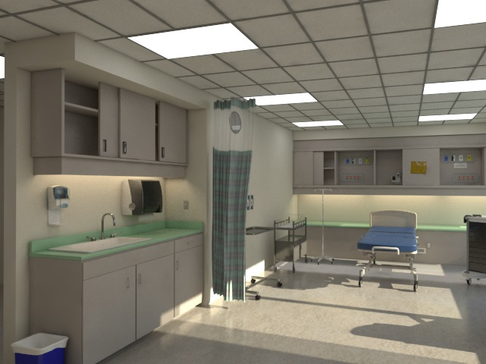
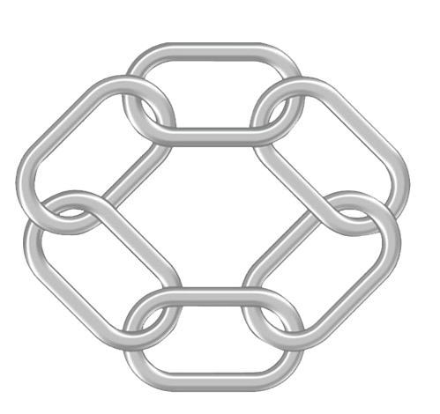
)
OVERVIEW
An important element of Routine Practices is the Chain of Transmission and Risk Assessment.
In this component, you will learn about:
the Chain of Transmission model
breaking the links in the Chain
Risk Assessment (both organizational and personal)
Infectious Agent
Susceptible Host
Reservoirs
Chain of
Transmission
Portals
of Entry
Portals of Exit
Modes of Transmission
Notes:
An important element of Routine Practices is the Chain of Transmission and Risk Assessment.
This learning component deals with the Chain of Transmission, breaking the links in the Chain to prevent infections and organizational and personal Risk Assessments. You will learn about the six links in the Chain of Transmission and how to break the links in the Chain to prevent infection. To help protect yourself and others, you will also learn about infection control measures and the steps you need to take when performing a Risk Assessment.

Slide 4
Objectives
Describe the six links in the Chain of Transmission and how they relate to the development of infections.
Use infection prevention and control strategies to “break the links” in the Chain of Transmission.
Perform a Risk Assessment before each task to evaluate the potential risk of infection.
Notes:
The objectives of this component are to:
Describe the six links in the Chain of Transmission and how they relate to the development of infections
Use infection prevention and control strategies to “break the links” in the Chain of Transmission
Perform a Risk Assessment to evaluate the potential risk of getting an infection
In your workplace, you may be called “staff” or “health care provider” or “health care worker”. In this component, we’ll use the term “health care provider”.
Notes to Trainers/Facilitators: You can use the warm up activity before discussing the Chain of Transmission.

Slide 5
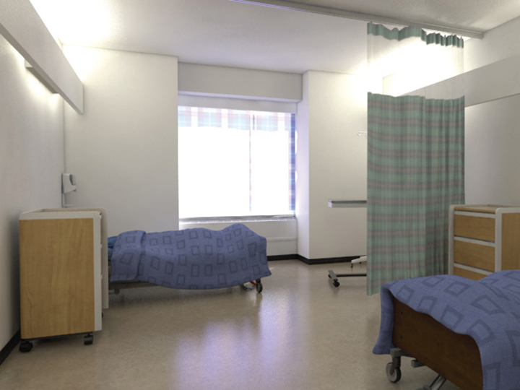
CHAIN OF TRANSMISSION
The Chain of Transmission is a model used to explain how:
infectious Agents are spread
infections can be prevented
An infection cannot develop unless all six of the links in the Chain are present and connected!
Infectious Agent
Susceptible Host
Reservoirs
Chain of
Transmission
Portals
of Entry
Portals of Exit
Modes of Transmission
Notes:
Sometimes we call microorganisms “germs.” This is when the microorganism can cause an infection. The microorganism is then known as an “Infectious Agent.” Microorganisms can be found in every health care setting.
The goal of infection prevention and control is to stop or reduce the transmission or spread of Infectious Agents.
To help us understand how Infectious Agents are spread, you need to understand the Chain of Transmission model. It is used to help understand how infections are spread and how they can be prevented.
Each link in the Chain represents a part of the process that can lead to an infection.
An infection cannot develop unless all six of the links in the Chain are present and connected. The links in the Chain can be broken to help prevent the transmission of infections. We will come back to this later.

Slide 6
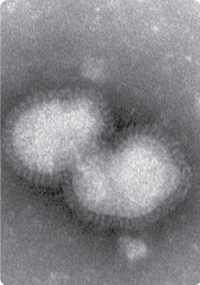
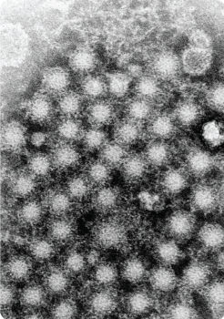
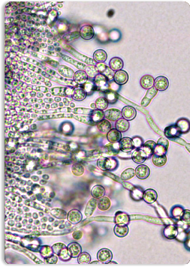
Infectious Agents include:
bacteria
viruses
fungi
CHAIN OF TRANSMISSION
Infectious agent
Susceptible Host
Reservoirs
Chain of
Transmission
Portals
of Entry
Portals of Exit
Modes of Transmission
Notes:
Let’s talk about the first link in the Chain of Transmission: Infectious Agents.
We need to begin this discussion by talking again about microorganisms. Microorganisms are everywhere and many are harmless and necessary for health. Most do not lead to infections. They are very small and the majority can only be seen under a microscope. If they were visible, people would clean their hands more often and environmental cleaning would be much easier, too!
Sometimes we call microorganisms “germs.” This is when the microorganism can cause an infection. The microorganism is then known as an “Infectious Agent.”
In order for any infection to occur, there needs to be an Infectious Agent. The Infectious Agent is the first link in the Chain of Transmission.
In health care, the Infectious Agents we deal with on a regular basis are bacteria, viruses and fungi.
Bacteria are the most common Infectious Agents we see in health care. An example is the bacterium that causes an infection known as “strep throat”. This bacterium is called “Streptococcus”.
Have you ever had food poisoning? This might have been caused by Salmonella bacteria, which is a common cause of food poisoning.
Viruses are also Infectious Agents. Serious illnesses and death can be caused by viruses like hepatitis and influenza (commonly known as “the flu”).
Another type of Infectious Agent is fungi. A common fungus that most of us have heard about is the one that causes “athlete’s foot”. You may also have seen “thrush mouth” in a baby.

Slide 7
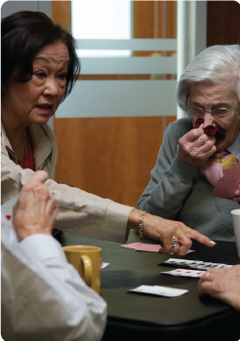
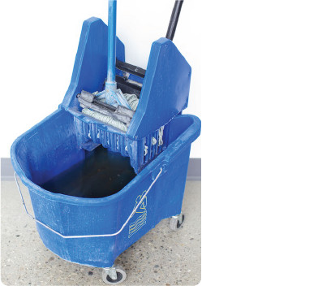
Reservoirs include:
people
water
food
CHAIN OF TRANSMISSION
Infectious agent
Reservoirs
Susceptible Host
Chain of
Transmission
Portals
of Entry
Portals of Exit
Modes of Transmission
Notes:
The second link in the chain is the “Reservoir”.
This is where microorganisms live and grow.
Examples of Reservoirs are people, animals, insects, water or food.
Everyone has had some sort of infection in their lives. This means that you have been the Reservoir where an Infectious Agent has lived and grown.
If a water supply became contaminated this would be an example of how water can be a Reservoir.
Anyone who has ever had food poisoning has first-hand knowledge of how food can be a Reservoir for infection.

Slide 8
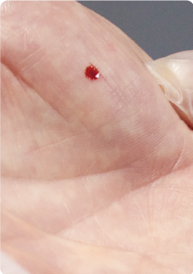
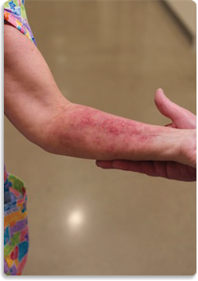
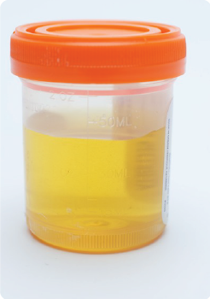
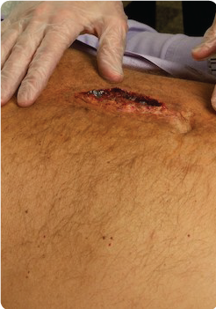
Portals of Exit include:
blood
secretions
excretions
skin
CHAIN OF TRANSMISSION
Infectious agent
Susceptible Host
Reservoirs
Chain of
Transmission
Portals of Exit
Portals
of Entry
Modes of Transmission
Notes:
The third link in the Chain is how Infectious Agents (or microorganisms) leave the Reservoir – or the “Portal of Exit”.
There are many Portals of Exit from the human body.
If someone has a blood infection the Portal of Exit may be a cut in the skin.
If someone has a respiratory infection, a cough or sneeze can spread infection.
Uncontained drainage from a wound can be a Portal of Exit and spread infection.
Touching the skin of someone with a skin infection has the potential to spread germs.

Slide 9
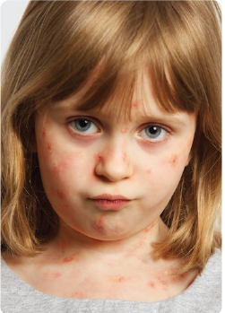
Modes of Transmission include:
contact
droplet
airborne
CHAIN OF TRANSMISSION
Infectious agent
Susceptible Host
Reservoirs
Chain of
Transmission
Portals
of Entry
Portals
of Exit
Modes of Transmission
Notes:
The fourth link in the chain is the “Mode of Transmission.”
Most Infectious Agents can’t travel by themselves. They need a way to move from one place to another. This is called the Mode of Transmission.
In health care we focus on 3 main Modes of Transmission: contact, droplet and airborne.
The Infectious Agent travels from one host to another through contact, droplet or airborne routes. You will learn more about Mode of Transmission in the Additional Precautions Module.

Slide 10
Portals of Entry include:
mucous membrane (eyes, nose, mouth)
respiratory tract
gastrointestinal (GI) tract
broken skin
CHAIN OF TRANSMISSION
Infectious agent
Susceptible Host
Reservoirs
Chain of
Transmission
Portals
of Entry
Portals of Exit
Modes of Transmission
Notes:
The fifth link in the Chain is the “Portal of Entry.”
This is how the Infectious Agent enters a new host.
Portals of Entry include the mucous membranes of your eyes, the respiratory tract, the gastrointestinal tract or broken skin.
For example, you can eat an Infectious Agent like salmonella. You can get an Infectious Agent, like Staph aureus, in a cut. Your eyes, nose, mouth (mucous membranes) can be exposed to an Infectious Agent like Influenza!

Slide 11
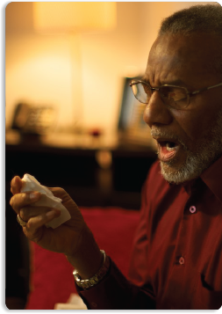
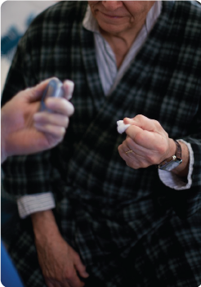
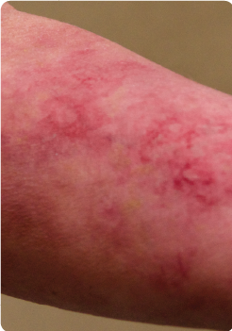
Susceptible Hosts include:
immunosuppression
diabetes
burns
surgery
Age – very young or very old
CHAIN OF TRANSMISSION
Infectious agent
Susceptible Host
Reservoirs
Chain of
Transmission
Portals
of Entry
Portals of Exit
Modes of Transmission
Notes:
The sixth link in the Chain is the “Susceptible Host.”
Anyone can be at risk of infection. The most vulnerable are people who are very young or very old, who have a poorly functioning immune system or illnesses such as diabetes. Individuals with burns or who have had surgery are also at increased risk because their skin is no longer intact.
When all these links are in place, infection will occur.
Notes to Trainers/Facilitators: Consider having discussion 1 after presenting this slide.
The discussion questions for this part are the same for Acute Care, Long-term Care and Community Care. If you want to leave the questions to the end of the presentation, you can skip the following slide.

Slide 12
Discussion
What kind of infection has made you miss work?
How do you get the common cold?
Who are the people who seem to get infections easily?
Notes:
Let’s “stop and think” about how Infectious Agents are spread.
What kind of infection has made you miss work?
How do you get the common cold?
Who are the people who seem to get infections easily?

Slide 13
CHAIN OF TRANSMISSION
The goal of infection prevention and control is to break one or more links in the Chain to prevent the spread of Infectious Agents and the development of infection.
Infectious Agent
Susceptible Host
Reservoirs
Breaking the
Chain of
Transmission
Portals
of Entry
Portals of Exit
Modes of Transmission
Notes:
You can stop the spread of infection by breaking any of the links in the Chain of Transmission.
The spread of Infectious Agents does not occur and infection does not develop if any of the links are eliminated or “broken”.
Let’s see what we can do to break the Chain.

Slide 14
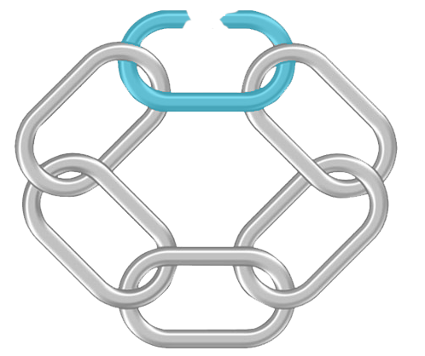
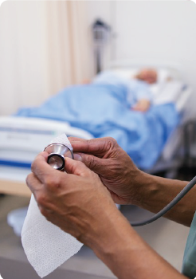
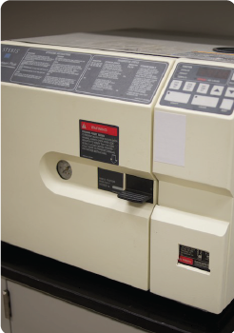
This chain is broken by:
antibiotics
disinfection
sterilization
CHAIN OF TRANSMISSION
Infectious
Agent
Susceptible Host
Reservoirs
Breaking the
Chain of
Transmission
Portals
of Entry
Portals of Exit
Modes of Transmission
Notes:
Let’s look at Infectious Agents. If there were no Infectious Agents, there would not be any infections. Killing or removing the Infectious Agent at the source can break the Chain. For example, antibiotics, disinfection or sterilization will kill Infectious Agents. Another example is the action of cleaning which decreases the number of Infectious Agents by physically removing them.
By removing the Infectious Agent, the risk of infection is reduced or eliminated.

Slide 15
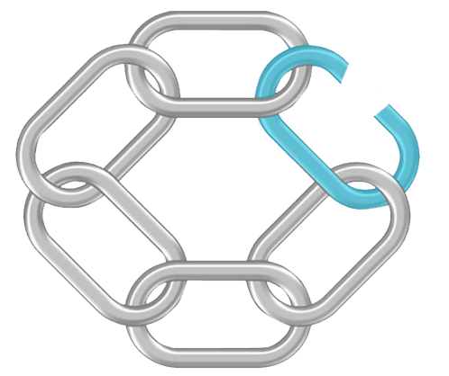
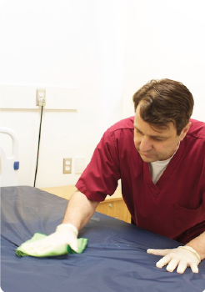
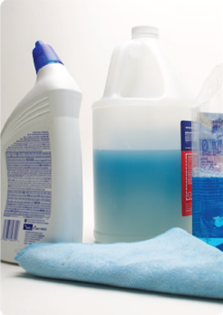
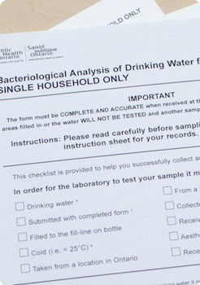
The chain is broken by:
Control of the Environment
environmental cleaning and disinfection
proper food storage
water treatment
CHAIN OF TRANSMISSION
Infectious Agent
Susceptible Host
Reservoirs
Breaking the
Chain of
Transmission
Portals
of Entry
Portals of Exit
Modes of Transmission
Notes:
The second link in the Chain is the Reservoir. If we can eliminate a Reservoir, the Infectious Agent will not have anywhere to live and grow.
We can eliminate the Reservoir by using effective Controls of the Environment and by cleaning the environment. For example, if we store food properly and treat water, Infectious Agents cannot grow there.
In this way the Chain of Transmission is broken by eliminating the place where Infectious Agents live and grow.

Slide 16
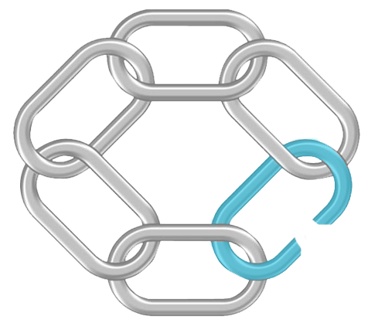
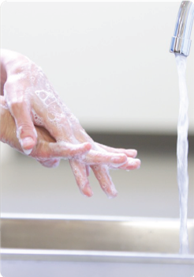
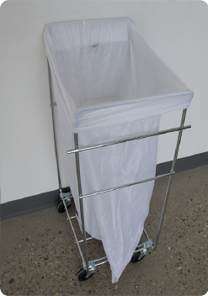
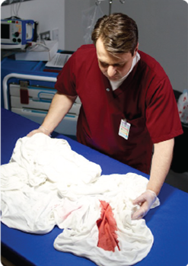
The chain is broken by:
hand hygiene
disposal of waste and contaminated linen
control of excretions and secretions
CHAIN OF TRANSMISSION
Infectious Agent
Susceptible Host
Reservoirs
Breaking the
Chain of
Transmission
Portals
of Entry
Portals
of Exit
Modes of Transmission
Notes:
Another way to break the Chain of Transmission is managing how Infectious Agents leave the body or other Reservoirs through the Portal of Exit. We need to manage all blood and body fluids, excretions and secretions which exit from the body or onto contaminated surfaces, in a way that helps reduce the risk of infection.
For example, when we sneeze, if we cover our mouth and nose we will prevent the droplets from travelling through the air and contaminating surfaces.
Another way to manage the Portal of Exit is by practicing good hand hygiene, safely disposing of waste and contaminated linen, and containing excretions and secretions.
This link in this Chain is broken by managing the Infectious Agents as they exit the body and contaminate surfaces or other Reservoirs, such as equipment, linen and waste.

Slide 17
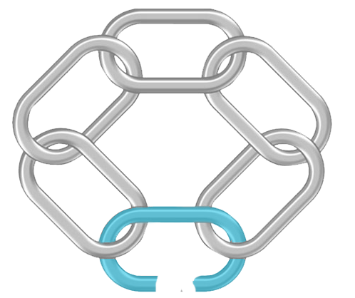
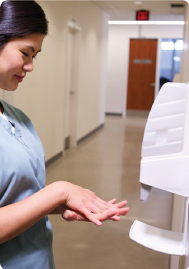
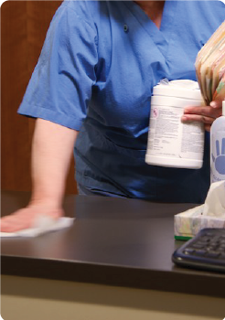
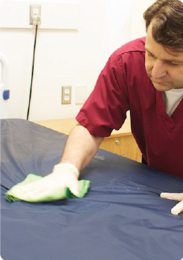
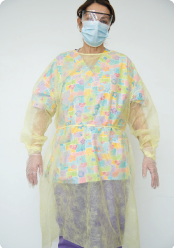
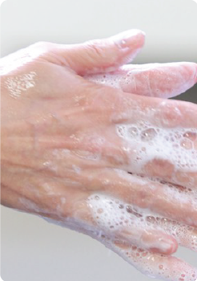
The chain is broken by:
spatial separation
control of the Environment
environmental sanitation
equipment disinfection or sterilization
Personal Protective Equipment (PPE)
hand hygiene
CHAIN OF TRANSMISSION
Infectious Agent
Susceptible Host
Reservoirs
Breaking the
Chain of
Transmission
Portals
of Entry
Portals of Exit
Modes of Transmission
Notes:
The link that health care providers can control most easily is the Mode of Transmission.
Preventing Infectious Agents from travelling breaks the Chain of Transmission by keeping them from reaching the Susceptible Host.
The single most important action you can take to prevent the transmission of infection is to perform hand hygiene.
Another way to prevent Infectious Agents from travelling is to maintain a spatial separation, such as keeping a 2 metre distance from someone who is coughing, or by using single rooms.
Proper air flow is an example of a Control of the Environment that improves air quality and stops Infectious Agents from travelling.
Environmental sanitation, (or environmental cleaning) and equipment disinfection are important in controlling Infectious Agents that can be spread by touch (or contact).
The proper use of Personal Protective Equipment helps prevent Infectious Agents from travelling from person-to-person and to the environment.

Slide 18
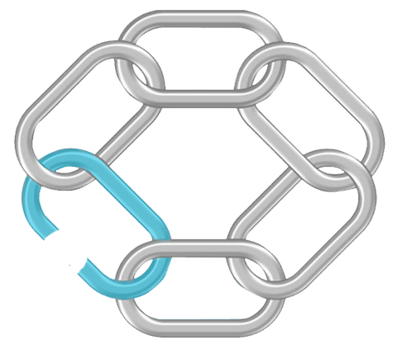
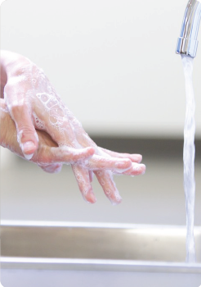
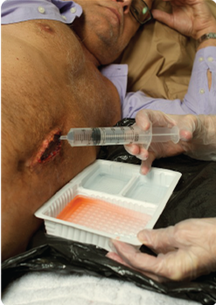
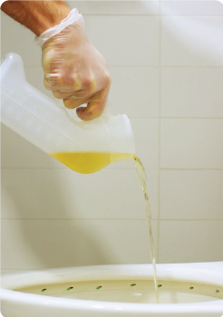
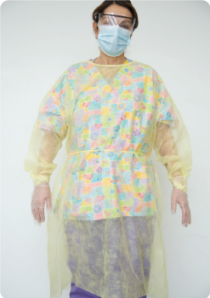
The chain is broken by:
hand hygiene
aseptic technique
wound care, catheter care
PPE
CHAIN OF TRANSMISSION
Infectious Agent
Susceptible Host
Reservoirs
Breaking the
Chain of
Transmission
Portals
of Entry
Portals of Exit
Modes of Transmission
Notes:
Controlling the Portal of Entry means keeping the Infectious Agent from entering a Susceptible Host.
If we provide care with clean hands and use aseptic technique when caring for patients, we can stop Infectious Agents from entering a client, patient, or resident who might be at risk of infection.
Proper techniques when we perform procedures such as wound care and catheter care help prevent infections, too.
Again, using Personal Protective Equipment correctly helps prevent client, patient, or resident infections related to the Portal of Entry.

Slide 19
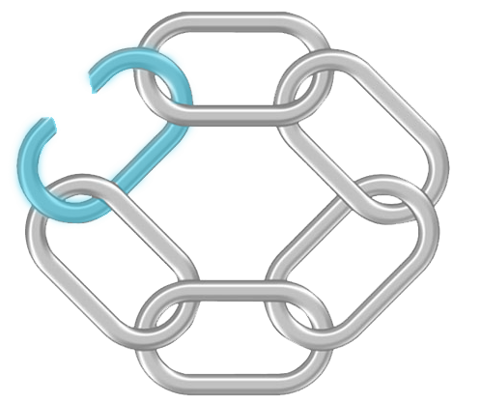
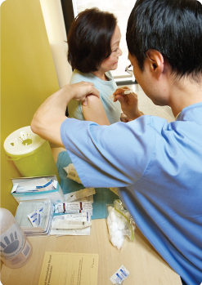
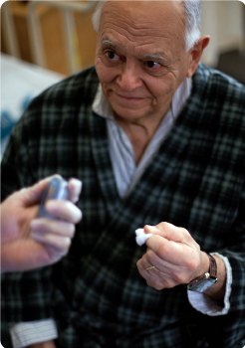
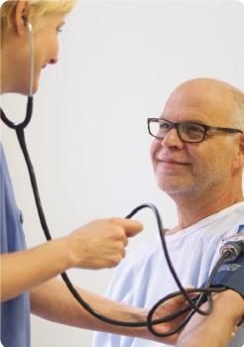
The chain is broken by:
immunization
nutrition
recognition of high-risk patients
treatment
CHAIN OF TRANSMISSION
Infectious Agent
Susceptible Host
Reservoirs
Breaking the
Chain of
Transmission
Portals
of Entry
Portals of Exit
Modes of Transmission
Notes:
What about Susceptible Hosts? If a person is not susceptible to an Infectious Agent, he or she cannot get an infection.
Immunity develops from receiving vaccines or may result from getting an infection, such as chickenpox.
When a client, patient, or resident receives treatment such as pre-operative antibiotics, it reduces their risk of infection.
A healthy lifestyle with exercise, enough sleep and good nutrition helps clients, patients, or residents have a better immune system.
When we are as healthy as we can be, we are less at risk of infection and are more likely to fight off infections.
Notes to Trainers/Facilitators: Consider having discussion 2 after presenting this slide.
The discussion questions for this part are sector specific. Please select the discussion questions that are closely related to the workplace setting of your learners. If you want to leave the questions to the end of the presentation, you can skip the discussion slide.

Slide 20
Discussion for Acute Care
How does hand hygiene prevent the spread of infection?
What actions do I take to minimize the growth and spread of infectious agents to protect my patients?
Why is cleaning and disinfection in health care important?
Infection is a hazard for patients as well as healthcare providers. What steps do I need to take to stay healthy and reduce my risk of getting an infection so I can protect myself and my patients?
Notes:
Let’s “stop and think” about how we can break the Chain of Transmission.
Consider the following questions:
How does hand hygiene prevent the spread of infection?
What actions do I take to minimize the growth and spread of infectious agents to protect my patients?
Why is cleaning and disinfection in health care important?
Infection is a hazard for patients as well as healthcare providers. What steps do I need to take to stay healthy and reduce my risk of getting an infection so I can protect myself and my patients?

Slide 21
Discussion for Long-Term Care
How does hand hygiene prevent the spread of infection?
What actions do I take to minimize the growth and spread of infectious agents to protect my residents?
Why is cleaning and disinfection in health care important?
Infection is a hazard for residents as well as healthcare providers. What steps do I need to take to stay healthy and reduce my risk of getting an infection so I can protect myself and my residents?
Notes:
Let’s “stop and think” about how we can break the Chain of Transmission.
Consider the following questions:
How does hand hygiene prevent the spread of infection?
What actions do I take to minimize the growth and spread of infectious agents to protect my residents?
Why is cleaning and disinfection in health care important?
Infection is a hazard for residents as well as healthcare providers. What steps do I need to take to stay healthy and reduce my risk of getting an infection so I can protect myself and my residents?

Slide 22
Discussion for Community Care
How does hand hygiene prevent the spread of infection?
What actions do I take to minimize the growth and spread of infectious agents to protect my clients?
Why is cleaning and disinfection in health care important?
Infection is a hazard for clients as well as healthcare providers. What steps do I need to take to stay healthy and reduce my risk of getting an infection so I can protect myself and my clients?
Notes:
Let’s “stop and think” about how we can break the Chain of Transmission.
Consider the following questions:
How does hand hygiene prevent the spread of infection?
What actions do I take to minimize the growth and spread of infectious agents to protect my clients?
Why is cleaning and disinfection in health care important?
Infection is a hazard for clients as well as healthcare providers. What steps do I need to take to stay healthy and reduce my risk of getting an infection so I can protect myself and my clients?

Slide 23
RISK ASSESSMENT
A Risk Assessment is an evaluation of the interaction of the health care provider, the client/patient/resident and the environment to assess and analyze the potential for exposure to infectious disease.
The purpose of a Risk Assessment is to identify risks and reduce potential exposure to infectious diseases and other health and safety hazards.
Notes:
Breaking the links in the Chain of Transmission helps prevent the development of infection. But, how do you protect yourself from infection? And what can your health care setting do to help protect you and the health care environment in which you work? The answer is to perform a Risk Assessment.
The purpose of a Risk Assessment is to identify risks and reduce potential exposure to infectious diseases and other health and safety hazards.

Slide 24
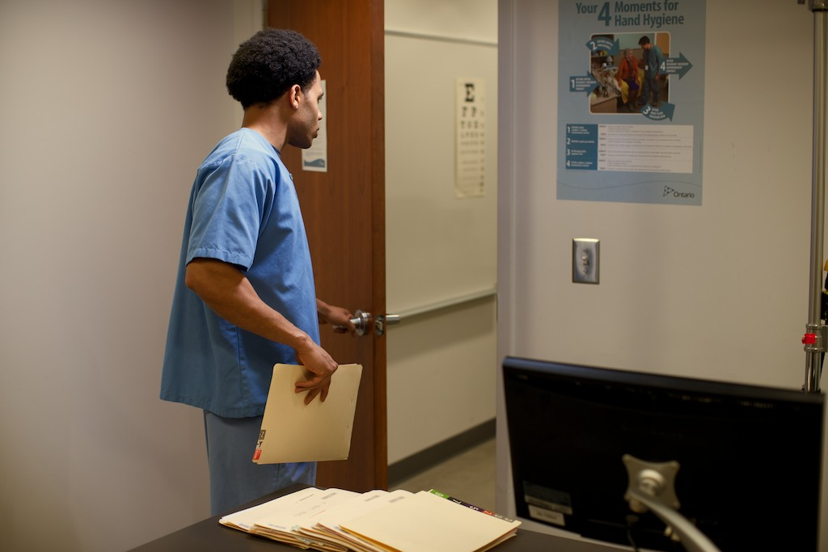
RISK ASSESSMENT
There are two types of Risk Assessments:
organizational Risk Assessment
personal risk assessment
Notes:
There are two types of Risk Assessments. One is done by the employer and one is done by the health care provider. Both are necessary to create a safe work environment.

Slide 25
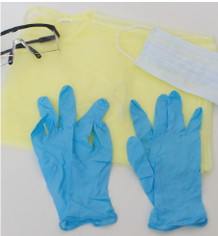
RISK ASSESSMENT
An organizational Risk Assessment is done by the employer to assess the need for:
Engineering Controls
safeguards built into the infrastructure of the health care setting
Administrative Controls
safeguards built into the management of the health care setting
Personal Protective Equipment (PPE)
provision of the necessary PPE for health care providers
Notes:
An Organizational Risk Assessment is done by your employer to assess the need for certain controls or safeguards. For example:
Engineering controls include safeguards built into the health care setting structure itself, such as special ventilation or dedicated hand washing sinks. In addition, cleaning processes for the environment and equipment as well as physical barriers and linen, waste and dish or utensil management are included in this. An additonal Risk Assessment needs to be done by the employer in each health care setting.
Administrative Controls are safeguards introduced by the management of each health care setting to continue to make the workplace safe, such as having clear and current policies for cleaning and health care provider education and training.
Provision of the necessary Personal Protective Equipment, or PPE, such as gloves,. gowns, masks and eye protection, is another important safety measure that must be provided by your employer.
Once your employer identifies areas of risk related to infection prevention and control, interventions may be put into place to minimize those risks in order to protect you, your coworkers and clients, patients, or residents from getting an infection.
Health care providers do not have control over organizational Risk Assessments but may have input through their Joint Health and Safety Committee or Health and Safety representative. Health care providers DO have control over their personal Risk Assessment.

Slide 26
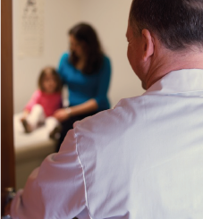
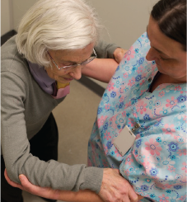
RISK ASSESSMENT
A Personal Risk Assessment is:
a thought process done by health care providers
performed before caring for a client/patient/resident or working in his/her environment
A Personal Risk Assessment asks questions about your own abilities and needs when performing tasks and duties.
Z
Notes:
A Personal Risk Assessment is a thought process that each health care provider must engage in before each and every interaction with a client, patient, or resident or their environment. This is necessary to help prevent the spread of infection.
A Risk Assessment helps health care providers in choosing interventions which help prevent the spread of Infectious Agents.
The Risk Assessment is necessary because other controls may be absent or do not completely eliminate the risk.
To help learn about Risk Assessment in the workplace, let’s consider how Risk Assessments are done by each of us every day.
For example, consider the decisions you make before crossing the street. Your “mental checklist” might include these questions:
Is there a car coming?
Is there a crosswalk?
Do I have time to get across safely?
In health care you need to use Risk Assessment questions in the same way to help guide your actions as you work.

Slide 27
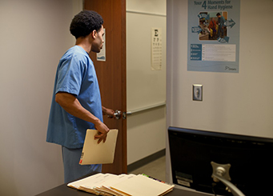
RISK ASSESSMENT
Perform a Personal Risk Assessment
before any interaction with a client/patient/resident
before any interaction with his or her environment
Notes:
The Risk Assessment is ongoing throughout your work day. As you become more comfortable with asking these questions, they will form an automatic “checklist” that you will do and re-do with each health care interaction you have with the client, patient, or resident and his or her environment.

Slide 28
RISK ASSESSMENT
When performing a personal Risk Assessment, ask yourself about:
the task
the physical and cognitive (mental) status of the client/patient/resident
the Controls of the Environment and Administrative Controls in place for your protection
Notes:
Every time you perform a personal Risk Assessment, ask yourself about the task, about the status of your client, patient, or resident and about the Controls of the Environment and Administrative Controls that are in place. This will help you identify whether you may be exposed to blood, body fluids, secretions, excretions or non-intact skin. This way you can choose controls or interventions that protect clients, patients, or residents as well as yourself.
Notes to Trainers/Facilitators: Consider having discussion 3 after presenting this slide.
The discussion questions for this part are sector specific. Please select the discussion questions that are closely related to the workplace setting of your learners. If you want to leave the questions to the end of the presentation, you can skip the discussion slide.

Slide 29
Discussion for Acute Care
Talk about how you do Risk Assessments every day at work in every patient interaction.

Slide 30
Discussion for Long-Term Care
Talk about how you do Risk Assessments every day at work in every resident interaction.

Slide 31
Discussion for Community Care
Talk about how you do Risk Assessments every day at work in every client interaction.

Slide 32
RISK ASSESSMENT
How to Perform a Personal Risk Assessment: The Task
Ask yourself questions about the task:
Do I have the equipment I need to do this task?
Gather the equipment and supplies needed before starting the task.
Notes:
How do you perform a personal Risk Assessment? Consider the tasks you are about to perform.
Do I have the equipment I need to do this task?
If the answer is no; Gather the equipment and supplies needed before starting the task.

Slide 33
RISK ASSESSMENT
How to Perform a Personal Risk Assessment: The Task
Ask yourself questions about the task:
Will I be touching blood, body fluids, secretions, excretions or other potentially infectious material?
Wear gloves if the task involves contact with blood, body fluids, secretions or excretions and clean your hands.
Notes:
Will I be touching blood, body fluids, secretions, excretions or other potentially infectious material?
If you answer yes - Wear gloves if the task involves contact with blood, body fluids, secretions or excretions and clean your hands.

Slide 34
RISK ASSESSMENT
How to Perform a Personal Risk Assessment: The Task
Ask yourself questions about the task:
Will my face be exposed to a cough or spray of saliva or blood?
Wear facial protection if the task exposes your face to saliva, blood or other body fluids.
Notes:
Will my face potentially be exposed to a cough or spray of saliva or blood?
Wear facial protection if the task exposes your face to saliva, blood or other body fluids.

Slide 35
RISK ASSESSMENT
How to Perform a Personal Risk Assessment: The Task
Ask yourself questions about the task:
Will my clothing or skin be exposed to splashes or sprays?
Wear a gown if the task exposes your clothing or skin to blood or body fluids.
Notes:
Will my clothing or skin potentially be exposed to splashes or sprays?
Wear a gown if the task exposes your clothing or skin to blood or body fluids.

Slide 36
RISK ASSESSMENT
How to Perform a Personal Risk Assessment: The Task
Ask yourself questions about the task:
How skilled am I at this task? Can I safely perform this task myself or do I need assistance?
Ask someone to assist you if necessary.
Notes:
How skilled am I at this task? Can I safely perform this task myself or do I need assistance?
Ask someone to assist you if necessary.

Slide 37
RISK ASSESSMENT
How to Perform a Personal Risk Assessment: Client/Patient/Resident Status
Ask yourself questions about the cognitive (mental) and physical status of this client/patient/resident.
Will he/she be able to follow directions?
You may need to change how you are going to provide the care for this client, patient, or resident.
Notes:
The next step in your personal Risk Assessment is to ask yourself questions about the status of your client, patient, or resident.
First, assess his or her cognitive or mental status:
Will he/she be able to follow directions?
You may need to change how you are going to provide the care for this client, patient, or resident.

Slide 38
RISK ASSESSMENT
How to Perform a Personal Risk Assessment: Client/Patient/Resident Status
Ask yourself questions about the cognitive (mental) and physical status of this client/patient/resident.
Remember to consider the extremes of age in your Risk Assessment because they may not be able to understand what you are trying to do.
Is he/she cooperative?
Notes:
Is he/she cooperative?
Remember to consider the extremes of age in your Risk Assessment because they may not be able to understand what you are trying to do.

Slide 39
RISK ASSESSMENT
How to Perform a Personal Risk Assessment: Client/Patient/Resident Status
Is he/she agitated or resistant?
You may need to change how you are going to provide the care for this client, patient, or resident.
Notes:
Is he/she agitated or resistant?
You may need to change how you are going to provide the care for this client, patient, or resident.

Slide 40
RISK ASSESSMENT
How to Perform a Personal Risk Assessment: Client/Patient/Resident Status
Ask yourself questions about the cognitive (mental) and physical status of this client/patient/resident.
Is he/she coughing, sneezing, vomiting or having diarrhea?
Wear gloves and a gown if you may be touching body fluids or excretions such as vomit or faeces. Wear a gown if your clothing or arms may be soiled with body fluids or excretions. Wear facial protection if your face may be exposed to a cough or sneeze.
Notes:
Now think about your client, patient, or resident’s physical status:
Is he/she coughing, sneezing, vomiting or having diarrhea?
Wear gloves and a gown if you may be touching body fluids or excretions such as vomit or faeces.
Wear a gown if your clothing or arms may be soiled with body fluids or excretions.
Wear facial protection if your face may be exposed to a cough or sneeze.

Slide 41
RISK ASSESSMENT
How to Perform a Personal Risk Assessment: Client/Patient/Resident Status
Ask yourself questions about the cognitive (mental) and physical status of this client/patient/resident.
Has he/she got a rash or fever?
Wear gloves if you may be touching a client, patient, or resident with a rash.
Notes:
Has he/she got a rash or fever?
Wear gloves if you may be touching a client, patient, or resident with a rash.

Slide 42
RISK ASSESSMENT
How to Perform a Personal Risk Assessment: Client/Patient/Resident Status
Is he/she incontinent or does he/she have uncontrolled drainage?
Wear gloves and a gown to clean the contaminated environment, and then clean your hands.
Notes:
Is he/she incontinent or does he/she have uncontrolled drainage?
Wear gloves and a gown to clean the contaminated environment, and then clean your hands.
Every client, patient, or resident interaction is different. That’s why it is so important to consider all these factors in your Risk Assessment

Slide 43
RISK ASSESSMENT
How to Perform a Personal Risk Assessment: Environment and
Administrative Controls
Ask yourself questions about controls already in place:
Are there facilities for cleaning my hands?
Know where your facility’s alcohol-based hand rub stations and hand washing sinks are located.
Notes:
Lastly, think about the controls that have already been put in place by your employer.
Ask yourself questions about the Administrative Controls and Controls of the Environment that are in place in your health care setting:
Are there facilities for cleaning my hands?
Know where your facility’s alcohol-based hand rub stations and hand washing sinks are located.

Slide 44
RISK ASSESSMENT
How to Perform a Personal Risk Assessment: Environment and
Administrative Controls
Ask yourself questions about controls already in place:
Are there any policies and procedures for me to follow?
Know the infection prevention and control policies and procedures in your health care setting.
Notes:
Are there any policies and procedures for me to follow?
Know the infection prevention and control policies and procedures in your health care setting.

Slide 45
RISK ASSESSMENT
How to Perform a Personal Risk Assessment: Environment and
Administrative Controls
Ask yourself questions about controls already in place:
Assess the need and availability for the client, patient, or resident to be in a single room, to be segregated from others or to have single toileting facilities.
Is a special environment necessary for this client/patient/resident to contain transmission?
Notes:
Is a special environment necessary for this client, patient, or resident to contain transmission?
Assess the need and availability for the client, patient, or resident to be in a single room, to be segregated from others or to have single toileting facilities.

Slide 46
RISK ASSESSMENT
How to Perform a Personal Risk Assessment: Environment and
Administrative Controls
Ask yourself questions about controls already in place:
Be sure there is a sharps container within reach. Use safety-engineered needles and medical sharps. Be aware of your health care setting’s protocol for exposure management.
Will I be using a sharp item or potentially be exposed to a sharp?
Notes:
Will I be using a sharp item or potentially be exposed to a sharp?
Be sure there is a sharps container within reach. Use safety-engineered needles and medical sharps. Be aware of your health care setting’s protocol for exposure management.
In this way, you will determine what you need to do to protect yourself and the client, patient, or resident. All of these questions and answers are part of your personal Risk Assessment.

Slide 47
HIERARCHY OF CONTROLS
Hazards in the workplace are controlled by:
Elimination/Substitution (most effective)
Controls of the Environment
Administrative Controls
Personal Protective Equipment (least effective)
These controls range from most effective (Elimination/Substitution) to least effective (use of Personal Protective Equipment).
Elimination /Substitution (most effective)
Controls of the Environment
Administrative Controls
PPE*
*PPE = Personal Protective Equipment (least effective)
Notes:
Let’s look again at hazards in the workplace.
An occupational health and safety model for this concept is the Hierarchy of Controls. These controls range from the most effective to the least effective.
Eliminating or Substituting the hazard is the most effective control.
Controls of the Environment and Administrative Controls are next, because these have already been put in place by your employer. You do not have to take action to use these.
Wearing Personal Protective Equipment is the least effective in the Hierarchy of Controls, because it relies on your own judgment and knowledge about how and when to use it. Use of Personal Protective Equipment is your last defense in the Hierarchy of Controls when other controls may be absent or do not completely eliminate the risk.
Let’s discuss each one of these different controls in turn. More information about controls will be discussed in the Controls of the Environment or Administrative Controls components of the Routine Practices Module.

Slide 48
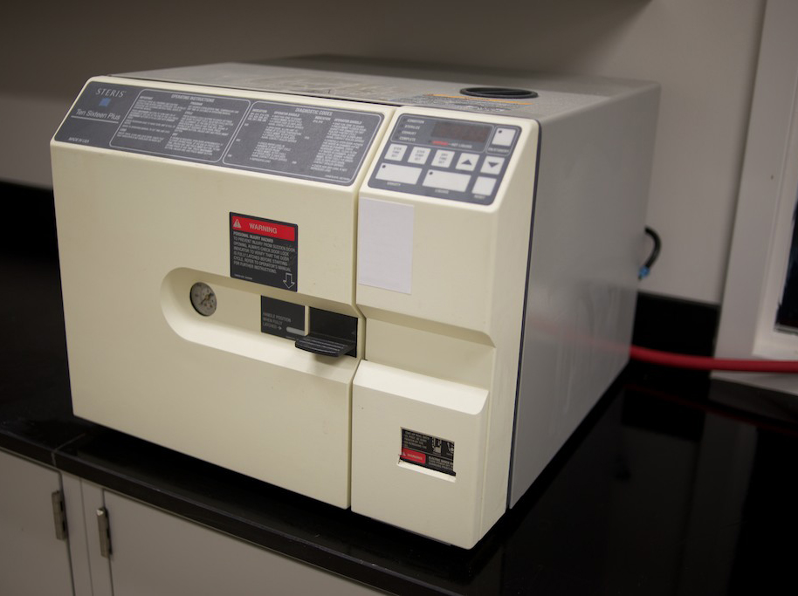
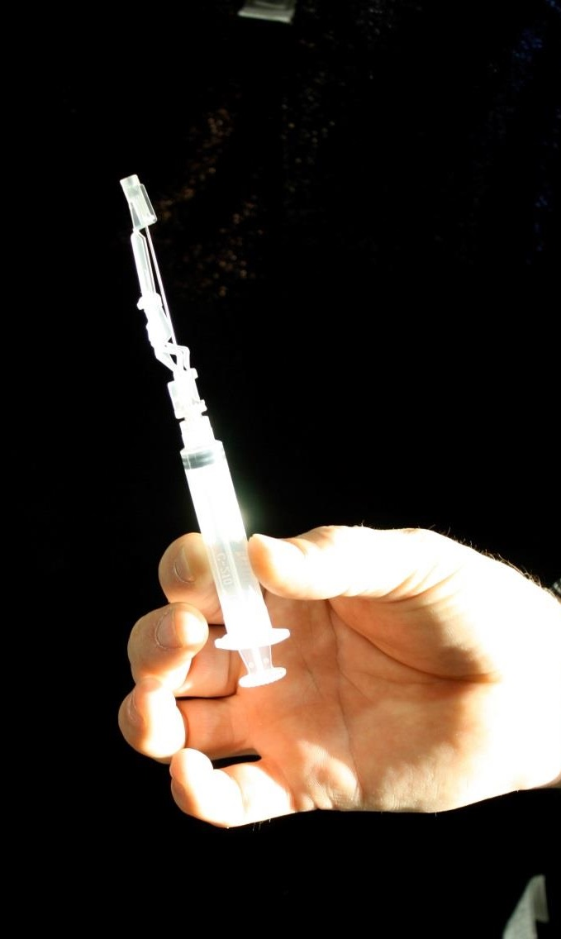
HIERARCHY OF CONTROLS
Elimination/Substitution
The most effective control is Elimination or Substitution of the hazard before injury can occur.
Sterilizer
Notes:
It would be ideal if a hazard could just be Eliminated or Substituted. Then the risk would no longer exist.
An example of the Elimination of a hazard is when medical equipment is sterilized. The Infectious Agents (the hazard) have been destroyed.
An example of controlling a hazard through substitution would be using a needleless intravenous system or using a medication patch instead of giving an injection.
Notes to Trainers/Facilitators: Please introduce the case study/practice activity after presenting this slide.
If you have skipped the discussions, it’s time to arrange the discussions.

Slide 49
SUMMARY: PART ONE
Two important elements in Routine Practices are:
understanding the Chain of Transmission and knowing how to break the links in the Chain of Transmission
performing Organizational and Personal Risk Assessments
The Chain of Transmission explains how:
Infectious Agents are spread
Infections can be prevented
The six links in the Chain are:
Infectious Agents
Reservoir
Portal of Exit
Mode of Transmission
Portal of Entry
Susceptible Host
An infection cannot develop unless all six of the links in the Chain are present and connected! Breaking the links in the Chain helps prevent the spread of Infectious Agents and the development of infection.
Notes:
Let’s summarize some of the key concepts.
First of all, it is important to recognize that there are two important elements of Routine Practices.
#1. You need a good understanding of the Chain of Transmission and how transmission can be stopped through breaking the links in the Chain.
#2. You need to know how to perform a Risk Assessment and incorporate Risk Assessment into your everyday activities.
The Chain of Transmission explains how:
Infectious Agents are spread
Infections can be prevented
The six links in the Chain are:
Infectious Agents
Reservoir
Portal of Exit
Mode of Transmission
Portal of Entry
Susceptible Host
When all six of the links in the Chain are present and connected, infections will develop.
Breaking the links in the Chain helps prevent infections.

Slide 50
SUMMARY: PART TWO
An organizational Risk Assessment is performed by the employer to:
put Controls of the Environment in place
put Administrative Controls in place
provide PPE as required
A personal Risk Assessment is performed by each health care provider to:
identify controls already in place
use additional measures, if needed
Notes:
There are organizational Risk Assessments and personal Risk Assessments.
Organizational Risk Assessments are done by the employer and risks that are identified are reduced by putting appropriate Controls of the Environment and Administrative Controls in place. Employers must also assure that Personal Protective Equipment is available for use by health care providers to help minimize exposure risks at work.
Each health care provider also has a responsibility to conduct personal Risk Assessments in the workplace. These must be done to identify control measures that are in place and so that you can put additional measures in place if needed (such as wearing Personal Protective Equipment).
Notes to Trainers/Facilitators: You can administer the test after presenting the summary.

Slide 51
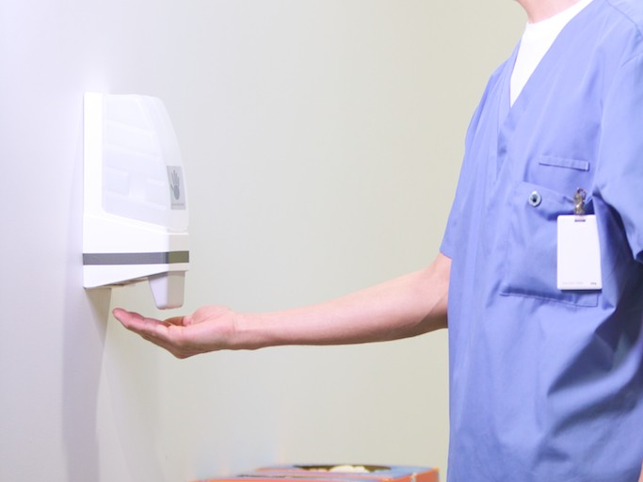
Thank you
Copyright 2014

