Slide 1
Construction, Renovation, Maintenance and Design
Planning phase

Slide 2
Objectives
Identify the components of the planning phase
Provide information on each component

Slide 3
Importance of IPAC during CRMD
Healthcare-associated infections (HAIs) have been attributed to construction, renovation, maintenance of health care facilities
Examples of HAIs associated with CRMD are legionnaires’ disease and invasive aspergillosis
Notes:
There are many examples of the healthcare-associated infections, aspergillosis and legionnaires’ disease, related to the construction, renovation, and maintenance of health care facilities. In some cases, there was significant morbidity and mortality. These infections can be prevented by using infection prevention and control measures such as installation of barriers, special air handling, and management or limitation of water features and fixtures.

Slide 4
Planning Project
ICP role
Perform Infection Control Risk Assessment (ICRA)
Review current guidelines and Ministry requirements
    Determine IPAC requirements
    Interpret IPAC guidelines for the team
Provide ongoing input into functional program
Serve as member of project team
Consult with experts
Review and sign off on technical drawings and plans
Notes:
There are key roles for infection control professionals, health care workers, and workers who carry out construction, renovation, maintenance and design. Roles for ICPs include monitoring compliance with IPAC procedures and policies, and monitoring for signs and symptoms of infections in patients. Health care workers help monitor compliance with IPAC and report potential cases of CRMD-associated infections in patients. Contractors and CRMD workers need to understand why IPAC measures are needed and how to implement them, such as constructing barrier walls and special ventilation.
Before and during the project, the ICP should perform an IPAC risk-assessment tool to determine critical planning and design features and validate the levels and types of IPAC preventive measures to be employed relevant to the type and extent of CRMD activity, and level of patient risk in the area. Preventive measures can be found in the CSA Z317.13.
The ICP responsibilities include involvement in the initial and ongoing development of the functional program for larger projects to ensure that IPAC features and measures are considered and included. The ICP should also be aware of and have available relevant documents such as the CSA documents, FGI guidelines as well as, for long-term care, the guidelines for design of long-term care facilities in Ontario. These documents provide invaluable guidance and information for all persons involved in construction, renovation, maintenance and design. It is critical that the ICP is able to interpret these guidelines for health care workers, contractors and CRMD workers as well as the project team.
The ICP should be a member of the project team for the entire project and all key aspects of CRMD. ICP may need to liaise with and educate project leads on the importance of IPAC involvement
If the ICP does not have experience with CRMD projects, it is important to consult with experts at another facility, local RICN or public health unit. In some cases, during the design and functional program phases, the ICP may be asked to review and sign off on plans to indicate IPAC compliance. Sign off may also be sourced to external IPAC experts.
ICPs should also determine if commissioning activities will take place to ensure the project complies with IPAC measures and is safe for patients. These commissioning activities should be part of the tender and planning processes.

Slide 5
Reviewing Design
ICP role
Ongoing review of technical drawings for IPAC considerations
  Hand hygiene sinks, traffic flow, clean and soiled storage areas, heating\ventilation and air conditioning (HVAC), airborne isolation rooms, sterile storage
  Review and provide feedback on choices of fixtures, finishes and decorative features
Notes:
When the functional program or plans are in place for the CRMD activity, the ICP plays a key role in the design phase.
The ICP will need to review specific technical drawings and specifications for the project design features and fixtures, such as hand hygiene sinks and ventilation.
Wall, ceiling and floor finishes, and decorative features can impact IPAC. Therefore, the ICP should be involved in selecting them. Finishes and features should be easy to clean and able to be disinfected. This means they need to be non-porous and smooth to prevent trapping debris and dirt in corners or crevices.
The ICP needs to review environmental features and fixtures to ensure they will not negatively impact IPAC or cause an IPAC risk. Features that can impact IPAC include water fountains, water walls, living walls, open planters for live plants, decorative wall and ceiling features such as lights or shelves, exposed pipes, and vents. Some features may pose risks for organisms such as Legionella spp or Aspergillus.
It is critical that the ICP know, understand, and be able to apply IPAC guidelines such as CSA, FGI, and the Ministry’s long-term care home design manual. The ICP will also need to interpret these to other team members.

Slide 6
Implementing CRMD Project
ICP role
Ensure contractor and workers have IPAC knowledge and education
Assist with IPAC education as needed for contractor, workers, healthcare providers and project team
Participate in review of schedules, activities and or CRMD meetings
Notes:
When the plans and designs are completed and before the project begins, the ICP needs to ensure the contractors and workers understand the IPAC requirements and the reasons for these requirements. The ICP should present the information in plain language on key infection risks such as legionnaires’ disease and aspergillosis. The project team should also receive this information.
When the contractor, workers, health care providers and project team understand the infection risks to patients, they are more likely to comply with the measures. It is important they understand that some patients are at higher risk.
The ICP should actively help to schedule key CRMD activities as well as CRMD meetings.

Slide 7
Infection Control Risk Assessment (ICRA)

Slide 8
Purpose
Identify critical planning and design features needed to reduce potential risks
Prevent infectious disease transmission through the construction, renovation and architectural design of a facility
Notes:
ICRA identifies locations and requirements for design elements, surfaces, and furnishings. The purpose is to reduce the risk of contamination during construction by using measures such as dust barriers, pressure differentials, and protection of air handlers.
The ICRA design recommendations should be incorporated into the project requirements and functional program. Further details about IPAC are in the Generic Output Specifications and Canadian Standards Association Z8000 and the FGI Guidelines for Design and Construction of Health Care Facilities, 2010 edition

Slide 9
Approach
Complete before the end of the design phase
Incorporate results into functional program and
  facility design
Update improvement recommendations throughout the planning, design, construction and commissioning phases
Address requirements for each building affected by the construction or renovation
Notes:
Conduct the infection control risk assessment before functional planning and design phase. The information from the assessment will inform the design of the facility and carry on throughout the construction and commissioning phases.
An ICRA is conducted by a panel with expertise in infection prevention and control and epidemiology , direct patient care, risk management, facility design, construction, ventilation, occupational health and safety.
The results of the ICRA should be integrated into the functional program and facility design by the architects, and engineers.
The risk assessment accompanied by updated improvement recommendations should be provided throughout planning, design, construction and commissioning phases.
The ICRA addresses building requirements that are expected to be affected by the construction or renovation.
If construction is taking place in the proximity of other buildings on the grounds of a health care facility, a risk assessment is required for each of the adjacent buildings where health care is provided.

Slide 10
Design Considerations
Population affected and or served
Numbers, location and types of airborne isolation and protective environment rooms
Location of special ventilation and filtration of HVAC
Air-handling and ventilation requirements in areas with special needs
Water systems to limit Legionella spp. and other waterborne opportunistic pathogens
Notes:
During the design phase, the IPAC recommendations need to be identified and included in the ICRA so they may be incorporated in the functional program. The ICRA is not intended to identify IPAC issues, but it should provide physical planning solutions to the identified issues and address the needs of patients.
Essential elements of an ICRA related to building design features include:
Numbers, locations, and types of airborne isolation (example: TB, bronchoscopy suites, bone marrow transplantation) and protective environment ( example bone marrow transplant)
2. Location of special ventilation and filtration of HVAC in areas such as emergency department triage, waiting and intake areas
3. Air handling and ventilation needs in surgical services, laboratories, local exhaust systems for hazardous agents/chemicals, and other areas with special needs as determined by the facility
4. Water systems that inhibit the growth of waterborne opportunistic pathogens such as Legionella spp.
5. Identifying appropriate finishes, furnishing and surfaces

Slide 11
Design Considerations
Number and location of
  Plumbed hand wash sink
  ABHR dispensers
Requirements for reprocessing area
Locations for emergency eye-wash stations
Number and location of storage areas
Clear separation between clean and dirty areas
Notes:
Additional key elements to include in the ICRA for the building design:
•Number and location of plumbed hand wash stations, including soap dispensers and paper towel dispensers
•Number and location of alcohol based hand rub (ABHR) dispensers
•Requirements for a reprocessing area, including number of required floor drains (determined by the type of equipment)
•Emergency/first-aid requirements (eye-wash stations);
•Number and location of storage areas

Slide 12
Design Considerations
Placement of personal protective equipment for use in delivery of care
Sufficient space and number of rooms to allow the placement of patients based on mode of transmission
Number of inpatient bedrooms designated as single bed rooms
Patient treatment places, (inpatient or outpatient), single occupancy
Human waste management systems
Finishes, furnishing and surfaces
Notes:
It is important to identify the location and placement of personal protective equipment for use in delivery of care
You will need to work with the project team to determine the number of Inpatient rooms designated as single bed rooms unless the functional program demonstrates the need for multi-patient rooms. Justification for two-bed rooms or multi-bed inpatient rooms will require supporting documentation explaining why, from a clinical standpoint, why multi-bed rooms are required. If multi bed rooms are used, there shall be one washroom with a toilet and a sink per patient/ resident.
The use of single bed rooms in other healthcare settings should be in accordance with their functional program.
Patient treatment places, (inpatient or outpatient), should be single occupancy unless the need for a multi-patient arrangement is determined by the functional program.
Single occupancy means that patients have a spatial separation and a physical barrier between them sufficient to provide privacy, protection from the spread of infection, and adequate area to support clinical functions

Slide 13
Design Considerations
Impact on patients / residents and employees
Determination of the specific hazards
Location of patients / residents (susceptibility to infection)
Impact on patients / residents during planned or unplanned outages, movement of debris, traffic flow, cleanup, testing and certification
Notes:
These are some essential elements of ICRA related to the existing building SITE. It is important to:
Identify the impact of disrupting essential services to patients/residents and employees. If renovations take place in an occupied facility, this could include water or ventilation shutdowns that may require the relocating patients to other areas.
2. Determine specific hazards and any additional protective measures that may be required. This could include removing asbestos during renovation projects which requires a higher level of preventive measures.
3. Locate and potentially relocate patients/residents based on their susceptibility to infection and risk. This would be determined using a risk assessment matrix that identifies the type of work being done, patient population and construction activity.
4. Consider impact to patients/residents with respect to the movement of debris, traffic flow, and cleanup. The facility might need to redirect traffic patterns for patients, staff and supplies to minimize exposure to dust and other contaminants associated with the construction

Slide 14
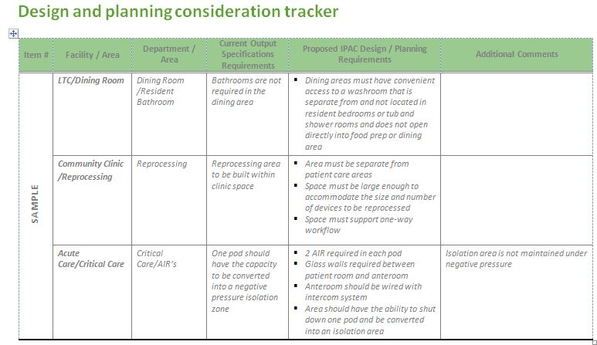
Design and Planning Tool - example
Image Source: Public Health Ontario, 2015
Notes:
This is an example of a tool that can be used for functional planning. It can be used when designing a whole facility (such as an acute care setting) as this one demonstrates, or it can be modified to use when constructing or renovating certain areas.

Slide 15
Key Functional Planning Considerations
Storage
  Consider equipment used in the areas
  Clean supply room designs
  Additional equipment storage
  Proper shelving
Needs of Patient/Client/Resident
  Hand-hygiene facilities
  Toileting facilities
  Shower/bathtub
  Storing personal supplies
Notes:
There are a large number of functional planning considerations. Refer to the CSA Z8000 and FGI guidelines for full details.
Consider what equipment is used and how it will be stored both before and after it is cleaned and disinfected. Make sure there is adequate space.
Keep in mind specific requirement for clean supply rooms, such as:
Proper shelving. Supplies should not be stored on or at floor level.
HVAC design to reduce dust and moisture.
Limited access for safety.
Consider the needs of clients/patients/residents with respect to infection prevention and control.
Plan adequate facilities for toileting and hand hygiene, as well as for storing some personal items in the patient/client /resident’s room or bathroom.

Slide 16
Key Functional Planning Considerations
Linen/laundry
  Process for management
  Storage requirements
Waste management
  All streams of waste considered
  Process for managing human waste
  Design of dirty utility room
Notes:
Consider how linen and laundry will be stored and managed. PIDAC recommends there should be a designated area on each client/resident/patient floor for storing clean linen. If you use a closed-cart system, then clean linen can be stored in an alcove. Plan adequate storage for both clean and soiled linens.
Also consider the process for managing waste and providing adequate space for bins. Keep in mind that there are several streams of waste such as regular waste, biomedical waste, chemo waste, and recycling.
Use the information and tools in this toolkit to help you plan and make decisions.

Slide 17
Key Functional Planning Considerations
Airborne Isolation Rooms (AIRs)
  Ensure negative pressure airflow
    Sufficient differential between supply and exhaust to maintain a pressure of 7.5PA between room and corridor
  Include audible and visual alarms at room and nurses’ station
  Exhaust system design is important
    To maintain negative pressurization
    Include back-up during maintenance or fan failure
Notes:
Perform a risk assessment to determine the need and best location for Airborne Infection Isolation or negative-pressure isolation rooms.
When designing the room, it is necessary to have an inward directional airflow from adjacent spaces or corridors to the room. Air should also be exhausted to the outside. Make sure it is not exhausted by a nearby air-intake fan. HEPA filtration of exhaust is required in cases where exhaust air is not discharged away from building openings or where there is a risk of recirculation of exhausted air.
Make sure there is an alarm system to alert staff if room pressure is not maintained.

Slide 18
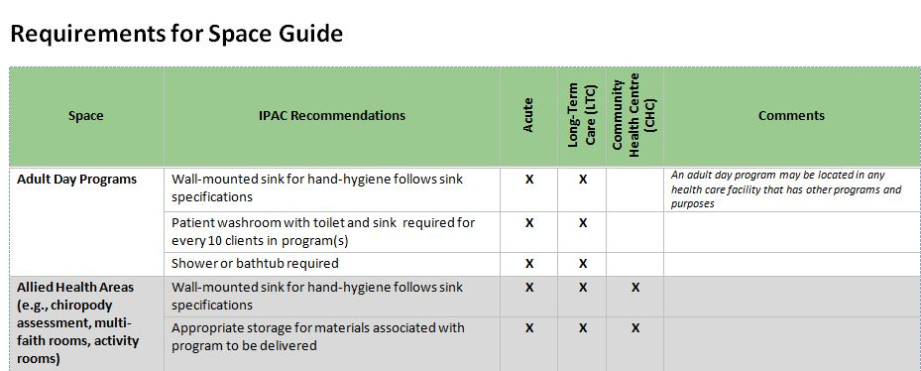
Guide for Space Planning
Provides guidance for spaces
  Listed by type of space
Consider if space is in your facility
  Do requirements apply?
Image Source: Public Health Ontario, 2015
Notes:
This guide is based on the type of space being planned and the type of health care facility; for example, acute versus long-term care.
The requirements to consider within that space are listed, and are based on references and guiding documents. Details from these documents are in the checklist and in the references.

Slide 19
Sources
Association for Professionals in Infection Control and Epidemiology; APIC Infection Control Tool Kit Series, Construction and Renovation, Second edition, May 2002
Association for Professionals in Infection Control and Epidemiology; APIC State-of-the-Art Report: The role of infection control during construction in health care facilities. Judene Mueller Bartley, MS, MPH, CIC; The 1997, 1998, and 1999 APIC Guidelines Committees
CSA Group. CSA Z317.13-12: Infection control during construction, renovation, and maintenance of health care facilities. Toronto, ON: CSA Group; 2012.
CSA Group. CSA Z8000-11: Canadian health care facilities. Toronto, ON: CSA Group; 2011.
Judene B, editor. Infection control toolkit series. construction and renovation. 2nd ed. Washington, DC: Association for Professionals in Infection Control and Epidemiology;2002.
Krasinski,K, et al Nosocomial fungal infection during hospital renovation. Infection Control Vol. 6, No. 7 (Jul., 1985), pp. 278-282
Ministry of Health and Long-Term Care, Infection Prevention and Control Planning and Design Guidelines for the Construction and Renovation of Community Health Centre, Version 1, July 2013

Slide 20
Sources
Ontario. Ministry of Health and Long-Term Care. Space planning guide for community health care facilities. Toronto, ON: Queen’s Printer for Ontario; 2015. Available upon request from: HealthCapitalInvestmentBranch@ontario.ca
Ontario Ministry of Health and Long-Term Care. Long Term Care Home Design Manual 2009 http://health.gov.on.ca/english/providers/program/ltc_redev/renewalstrategy/pdf/home_design_manual.pdf
Health Canada. Construction-related nosocomial infections in patients in health care facilities. Decreasing the risk of Aspergillus, Legionella and other infections. Can Commun Dis Rep. 2001;27S2:i-x, 1-42, i-x, 1-46. Available from: http://www.collectionscanada.gc.ca/webarchives/20071126081137/http://www.phac-aspc.gc.ca/publicat/ccdr-rmtc/01pdf/27s2e.pdf
Stout JE, Brennen C, Muder RR. Legionnaires' disease in a newly constructed long-term care facility. J Am Geriatr Soc. 2000 Dec;48(12):1589-92. PubMed PMID: 11129747

