Slide 1
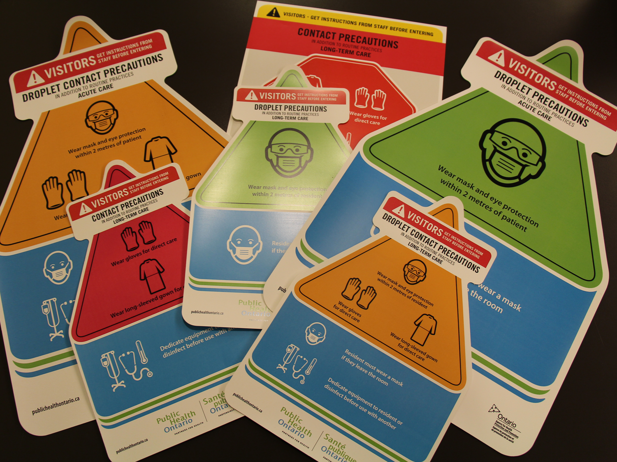
CORE COMPETENCY ADDITIONAL PRECAUTIONS
LONG-TERM CARE
Notes:
Welcome to the Infection Prevention and Control Core Competencies - “Additional Precautions”.

Slide 2
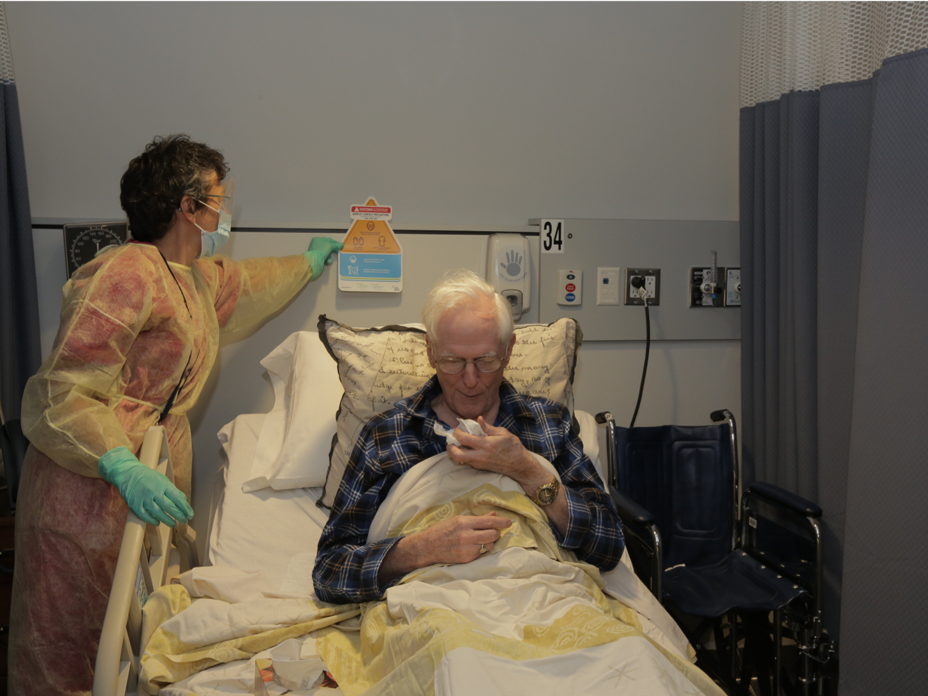

INTRODUCTION TO ADDITIONAL PRECAUTIONS
General Introduction to Additional Precautions
Additional Precautions are Infection Prevention and Control (IPAC) practices used:
in addition to Routine Practices
to interrupt the transmission of suspected or identified infectious agents
to protect health care providers and residents
Notes:
Additional Precautions are Infection Prevention and Control or IPAC practices used in addition to Routine Practices. Additional Precautions interrupt the transmission of suspected or identified infectious agents. When we use Routine Practices and Additional Precautions correctly, we will help protect ourselves AND we will help protect our residents from the transmission of infection.

Slide 3
OVERVIEW
In this course, you will learn about:
the principles of Additional Precautions
the categories of Additional Precautions
the elements that comprise each category of Additional Precautions
Notes:
In this course, you will learn about the principles and the categories of Additional Precautions. You will also learn about the elements that comprise each category of Additional Precautions.

Slide 4
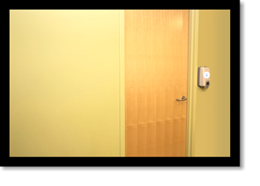
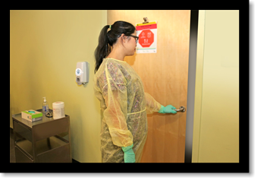

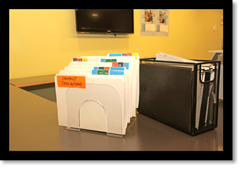
HAVE YOU EVER THOUGHT ABOUT…?
Notes:
Look at the pictures. Have you ever thought about:
Why a sign is posted on the door of a patient or resident room?
Why this health care provider is wearing gloves and a gown before entering the room?
Why there is a flag on a chart?

Slide 5
OBJECTIVES
After finishing this course, you will be able to:
describe the modes of transmission
define and describe the categories of Additional Precautions
apply the elements of Additional Precautions
Notes:
After finishing this course, you will be able to describe the modes of transmission, define and describe the categories of Additional Precautions. You will know when and how to use Additional Precautions. You will also be able to apply the principles and elements that comprise Additional Precautions.
In your workplace you may be called “staff” or “health care provider” or “health care worker”.
In this course, we’ll use the term “health care provider”.

Slide 6
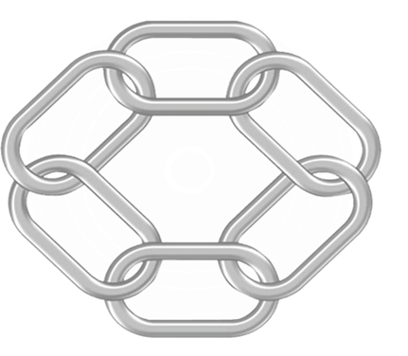
MODE OF TRANSMISSION
The three modes of transmission are:
Infectious Agents
Contact
Susceptible Host
Reservoirs
CHAIN
OF
TRANSMISSION
Droplet
Portal of Entry
Portal of Exit
Airborne
Mode of Transmission
Notes:
Do you remember the Chain of Transmission in the Routine Practices Core Competencies Course? In healthcare, there are three common modes of transmission. They are Contact, Droplet and Airborne.

Slide 7
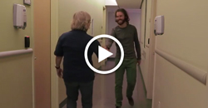
CONTACT TRANSMISSION
Direct Contact
Transmission occurs through one person touching another person.
If you can’t access the video click here to download all of the Core AP videos.
Notes:
There are two types of contact transmission: direct contact and indirect contact.
Direct contact transmission occurs through one person touching another person.

Slide 8
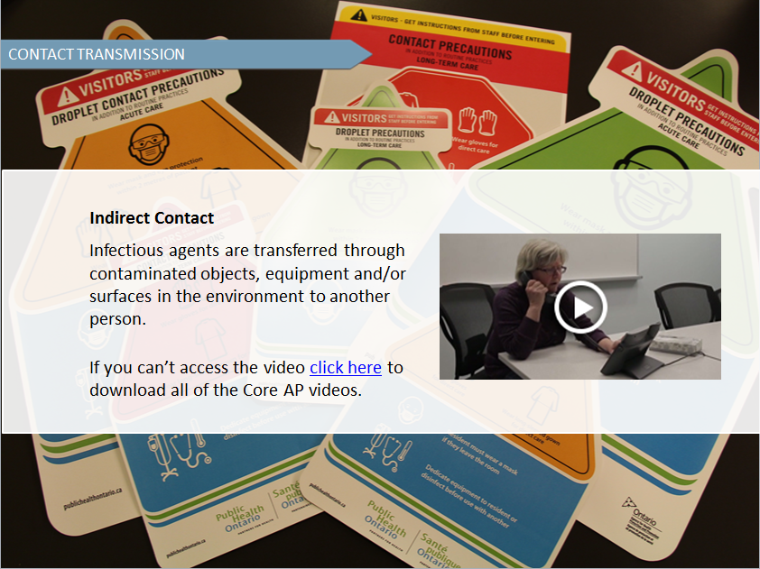
Notes:
Infectious agents are transferred through contaminated objects or environments.
Examples of organisms that can be transmitted by contact are norovirus and many antibiotic-resistant organisms.

Slide 9
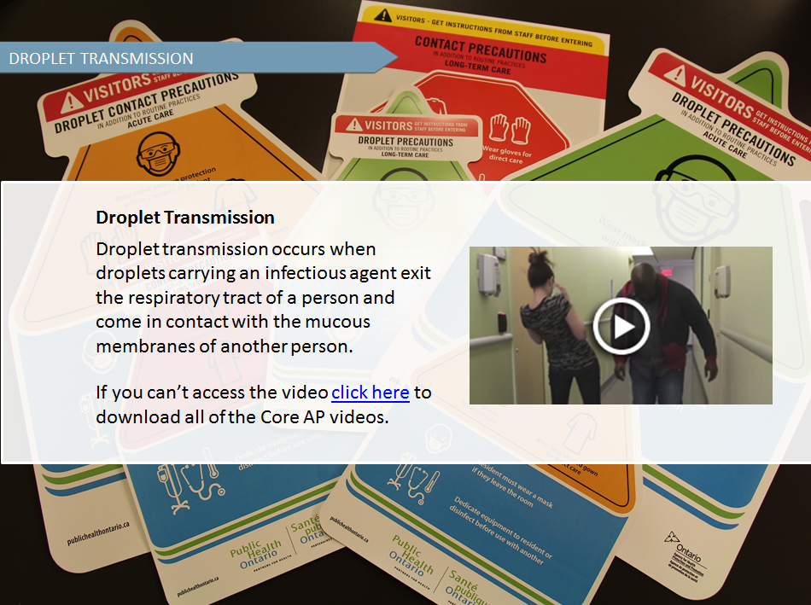
Notes:
Droplet transmission occurs when droplets carrying an infectious agent exit the respiratory tract of a person and come in contact with the mucous membranes (such as the eyes, nose and mouth) of another person. Mumps and pertussis are examples of droplet transmission.

Slide 10
DROPLETS
What do you know about droplets?
T
F
F
Droplets travel on air currents.
or
T
F
T
Droplets remain on horizontal surfaces.
or
Facts about droplets
Droplets:
do not remain in the air
may contain infectious agents
usually travel less than 2 metres
Infectious agents in droplets:
can land on surfaces
can contaminate the environment
Can live on surfaces for long periods of time
Notes:
What do you know about droplets?
Droplets travel on air currents. Is it true or false?
Droplets remain on horizontal surfaces? Is this true or false?
Here are some key facts about droplet transmission. When we cough or sneeze, we release droplets.
Droplets do not remain in the air, may contain infectious agents and usually travel less than two metres. Infectious agents in droplets can land on surfaces, contaminate the environment and can live on surfaces for long periods of time.

Slide 11
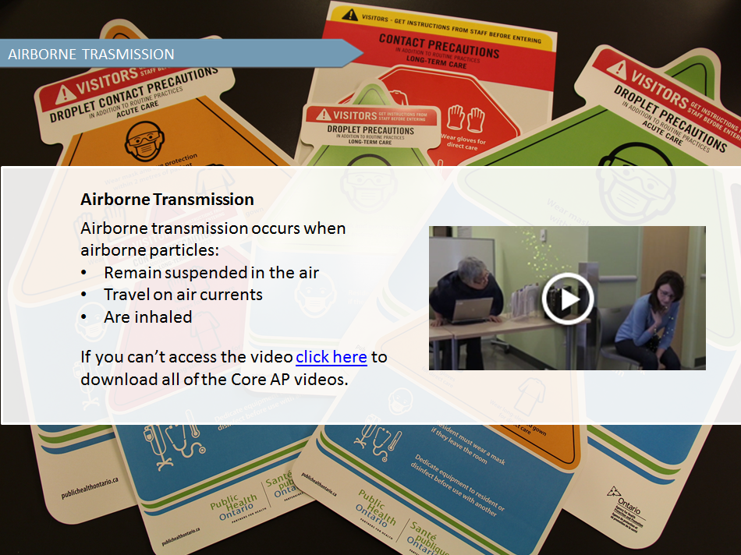
Notes:
Airborne transmission occurs when airborne particles remain suspended in the air, travel on air currents and are then inhaled by susceptible people who may be nearby or some distance away from the infected person.
Tuberculosis, chickenpox and measles are airborne.

Slide 12
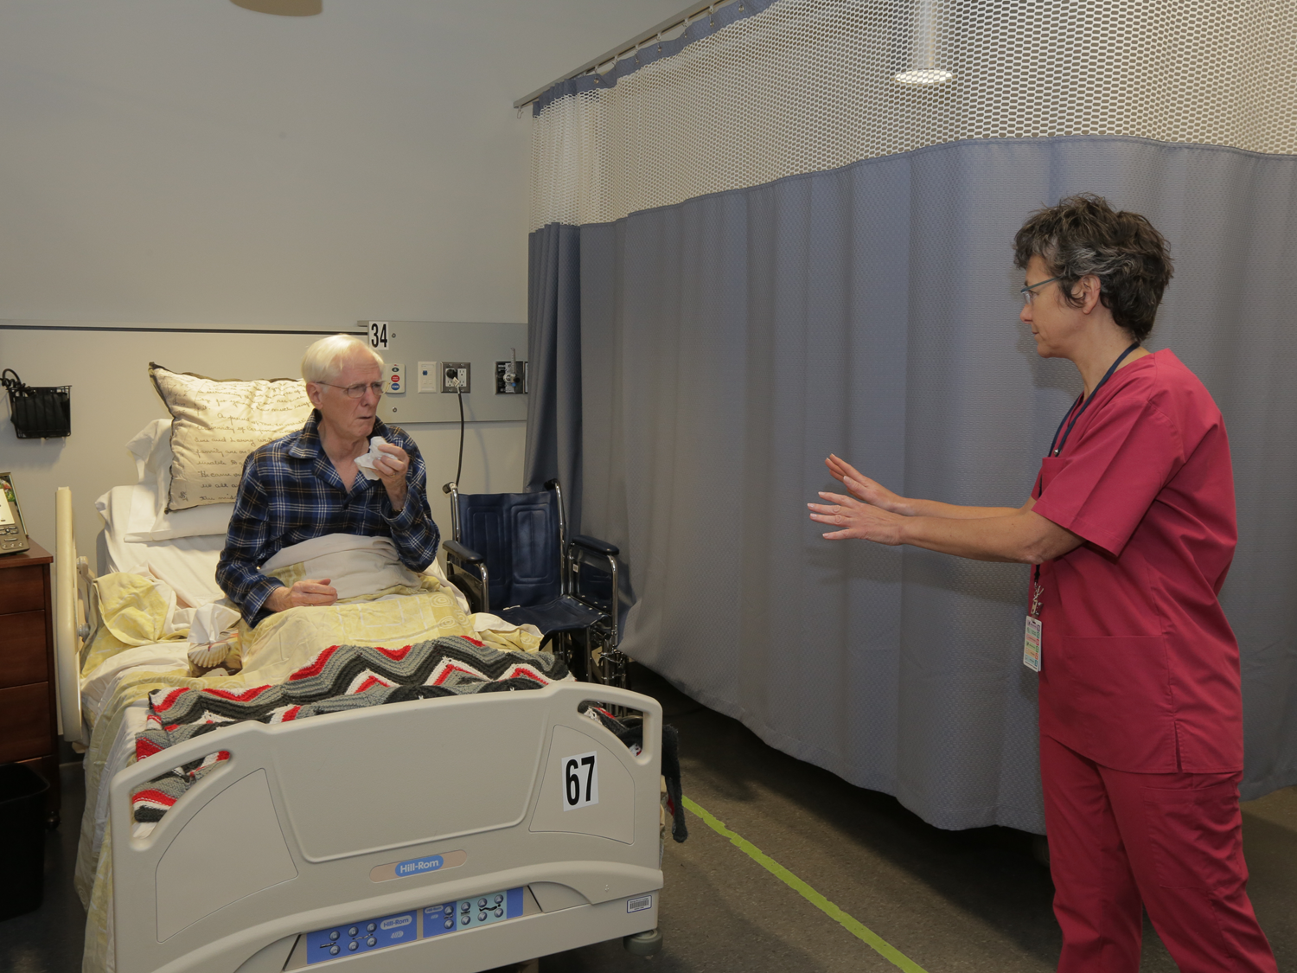
ADDITIONAL PRECAUTIONS
are used in addition to Routine Practices
are based on the mode of transmission
include Contact Precautions, Droplet Precautions and Airborne Precautions
may be combined depending on the infectious agents
Notes:
Additional Precautions are infection prevention and control measures used to manage certain known or suspect infectious agents. They are used when Routine Practices alone are not sufficient to prevent and control spread.
Additional Precautions are based on the mode of transmission.
There are three categories of Additional Precautions: Contact Precautions, Droplet Precautions and Airborne Precautions. Sometimes Additional Precautions are combined, depending on the infection or infectious agents.

Slide 13

STOP AND THINK
How do Additional Precautions relate to Routine Practices?
Notes:
Now it's time to stop & think. How do Additional Precautions relate to Routine Practices?

Slide 14
COMBINATIONS OF ADDITIONAL PRECAUTIONS
Which category/categories of Additional Precautions would help to prevent and control the spread of influenza?
How is influenza spread?
Which category/categories of Additional Precautions would help to prevent and control the transmission of croup?
How is croup transmitted?
When more than one mode of transmission of an infectious agent exists, use a combination of Additional Precautions
Most respiratory infections ⇒droplet + contact
Notes:
How is influenza spread? Which category or categories of Additional Precautions would help to prevent and control the spread of influenza?
How is croup transmitted? Which category or categories of Additional Precautions would help to prevent and control the transmission of croup?
Sometimes more than one mode of transmission exists for a particular infectious agent, so, more than one type of precautions would be needed.
Most respiratory infections need droplet-contact precautions since they are spread by both droplet and contact transmission.
When combinations of precautions are used, all elements of each type of precautions need to be applied.

Slide 15
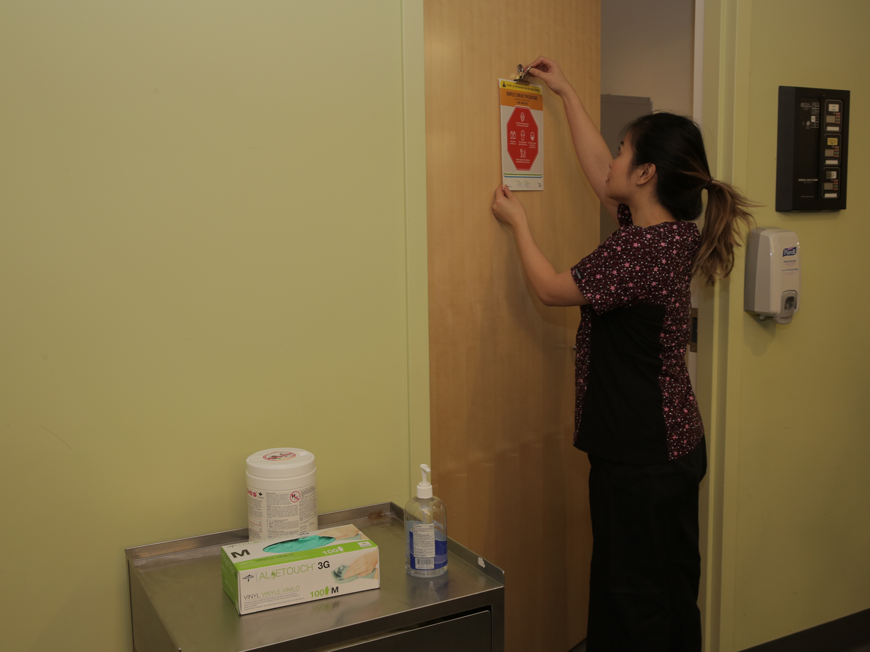
INITIATING ADDITIONAL PRECAUTIONS
Additional Precautions need to be initiated:
as soon as symptoms appear, not only when an infectious disease is diagnosed
by any regulated health care professional
based on your health care setting’s policies
Notes:
Additional Precautions must be initiated as soon as symptoms suggestive of a potentially transmissible infection are noted, not only when an infectious disease diagnosis is confirmed.
The initiation of Additional Precautions can be done be any regulated health care professional. This may include an RN, an RPN, a physician or an Infection Control Professional.
Each health care setting should have a policy regarding initiation of the appropriate Additional Precautions at the onset of symptoms. Do you know the procedure or protocol you need to follow for a rash with no known cause or new onset fever, cough and shortness of breath?
Whenever Additional Precautions are initiated, the person responsible for infection prevention and control must be notified. He or she will verify that the precautions are appropriate.

Slide 16
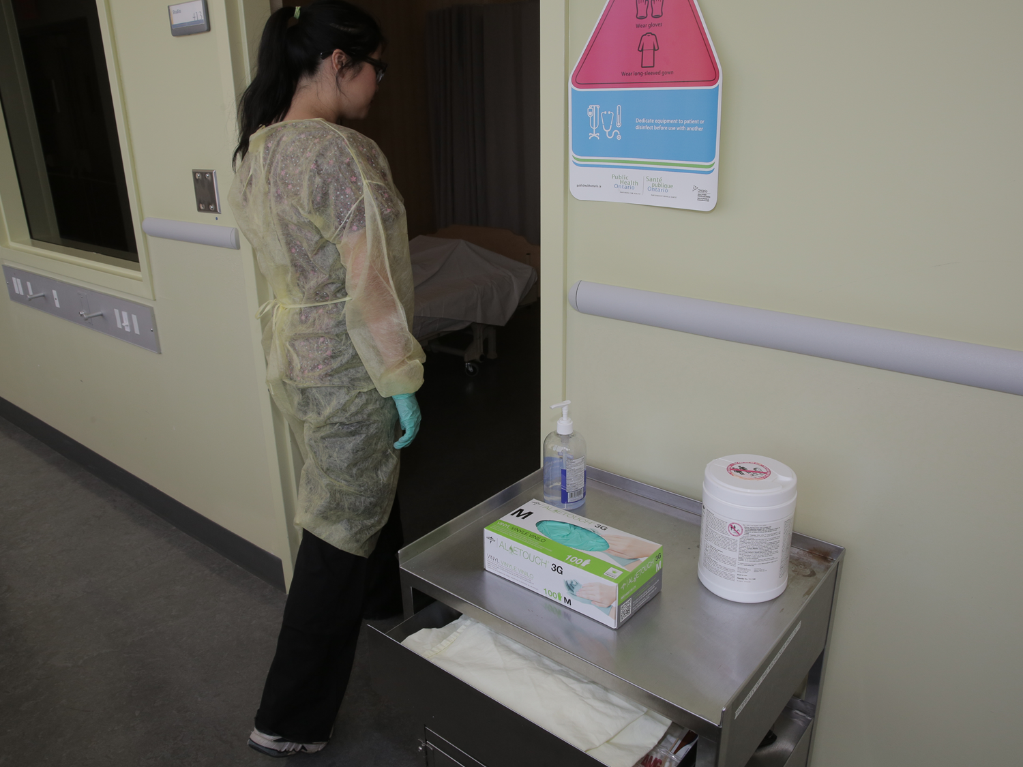
MAINTAINING ADDITIONAL PRECAUTIONS
Additional Precautions need to be reviewed and maintained until:
there is no longer a risk of transmission
discontinued by the person responsible for infection control
laboratory results are available to confirm or rule out the diagnosis
Notes:
Regular reviews by the person responsible for infection control may be done to determine when there is no longer a risk of transmission.
Additional Precautions need to be maintained until they are discontinued by a physician, infection control professional or designate.
Laboratory results may confirm or rule out the diagnosis.
Remember that being placed in a single room or remaining on Additional Precautions may impact a patient or resident’s well-being. All efforts should be made to maintain their quality of care.

Slide 17
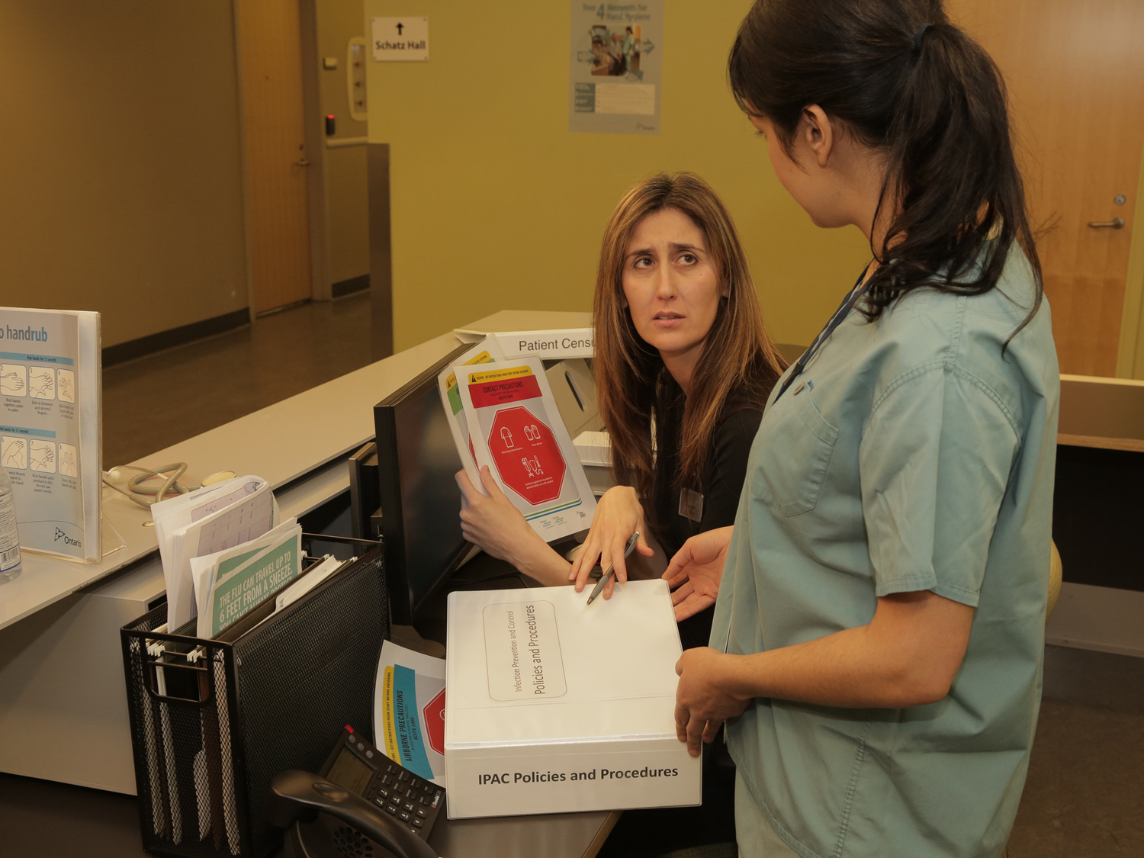
DISCONTINUATION OF ADDITIONAL PRECAUTIONS
Discontinuation of Additional Precautions:
should be done as soon as the risk of transmission is no longer present
must follow the policies of the health care setting
is done by the person responsible for Infection Prevention and Control or his/her designate
may require discussion with the attending physician
Notes:
The discontinuation of Additional Precautions should be done as soon as safely possible and when the risk of transmission is no longer present.
Each health care setting should have a policy regarding the factors to consider when discontinuing Additional Precautions.
The Infection Control Professional must be consulted prior to discontinuation of Additional Precautions and, in some cases, discussion with the attending physician may be needed.

Slide 18
POLICIES AND PROCEDURES OF ADDITIONAL PRECAUTIONS
Policies and procedures related to Additional Precautions may vary from organization to organization.
They may depend on:
the health care setting
the client/patient/resident population
the organization’s history of dealing with infections
Modifications necessary for medical or therapeutic purposes
Always:
follow your organization’s policies and procedures
contact your Infection Control Professional or designate to help with decision making
Notes:
Policies and procedures related to Additional Precautions may vary from organization to organization. They may depend on the health care setting, the client or patient or resident population, the organization’s history of dealing with infections.
It may be necessary to modify Additional Precautions for medical or therapeutic purposes.
Always follow your organization’s policies and procedures and contact your Infection Control Professional or designate to help with decision making.

Slide 19








ELEMENTS OF CONTACT PRECAUTIONS - LTC
Accommodation
dedicated toilet and sink
case-by-case consideration
door open
residents can leave room unless symptomatic
Notes:
Accommodation
The ideal accommodation for residents requiring Contact Precautions is a single room with a dedicated toilet and sink. Since this is often not possible in long-term care, each resident should be assessed on a case-by-case basis. The ability of the resident to follow precautions and the infection risk to other residents in the room should be considered in making the decision about accommodation. The door to the resident’s room may stay open. In most cases residents are able to leave their room. Exceptions may include the resident who has acute vomiting or diarrhea or a heavily leaking wound that cannot be contained.

Slide 20
ELEMENTS OF CONTACT PRECAUTIONS - LTC
Signage
at the room entrance or
by the bed space
Notes:
Signage
In a single room, a Contact Precautions sign needs to be put at the entrance to the resident’s room. If the resident is in a multi-bed room, then the sign needs to be put by the bed space so it is easily seen.

Slide 21
ELEMENTS OF CONTACT PRECAUTIONS - LTC
PPE
gloves and gown for direct care
Notes:
PPE
You will need to put on a gown and gloves when you are providing direct, hands-on care for the resident. If you are entering the room and will not be doing any direct care you do not need to wear personal protective equipment but should practice hand hygiene according to the 4 Moments.

Slide 22
ELEMENTS OF CONTACT PRECAUTIONS - LTC
Cleaning
routine cleaning
clean all high-touch surfaces daily
rooms of residents with Vancomycin Resistant Enterococcus (VRE) or Clostridium difficile (C. difficile) require special cleaning
remove and launder all curtains on discharge/transfer cleaning
Notes:
Cleaning
Routine environmental cleaning is sufficient for most residents on Contact Precautions. All high-touch surfaces, such as light switches and bed rails, must be cleaned daily.
Environmental services needs to be notified of any residents who have Vancomycin-Resistant Enterococcus (VRE) or Clostridium difficile (C. difficile) so that special cleaning can be done. Remove and launder privacy curtains as part of discharge or transfer cleaning.

Slide 23
ELEMENTS OF CONTACT PRECAUTIONS - LTC
Equipment
dedicate
clean according to Routine Practices
chart outside room
Notes:
Equipment
Dedicate equipment to the resident’s use whenever possible. Equipment that is shared between residents needs to be cleaned and disinfected after each use, based on Routine Practices, before being used with another resident. Paper or mobile electronic resident records should be kept outside of the resident room.

Slide 24
ELEMENTS OF CONTACT PRECAUTIONS - LTC
Communication to:
residents
families
other departments
other facilities
transport services prior to transfer
Notes:
Communication
It is important that you tell residents and their families why Contact Precautions are in place. Also ensure that other departments, facilities and transport service providers are aware of the need for Contact Precautions.

Slide 25
ELEMENTS OF CONTACT PRECAUTIONS - LTC
Transport
gloves and gowns for direct contact
clean and disinfect equipment used for transport
Notes:
Transport
Sometimes it is necessary for residents on Contact Precautions to be transported to another facility. If your resident needs to be transported, you need to wear gloves and gown only if you provide direct care for the resident during the transport. As a routine practice, after transport, clean and disinfect used equipment.

Slide 26
ELEMENTS OF CONTACT PRECAUTIONS - LTC
Visitors
education regarding hand hygiene
wear PPE for direct care
Notes:
Visitors
Show visitors how to clean their hands properly with alcohol-based hand rub or soap and water when they enter and leave the room. Visitors do not need to wear PPE unless they are providing direct care, such as assisting with toileting or bathing the resident.

Slide 27
ELEMENTS OF DROPLET PRECAUTIONS - LTC
Accommodation
resident stays in room
draw privacy curtain
door open
Notes:
Accommodation
In long-term care, residents should remain in their room or bed space, if feasible, with privacy curtains drawn. The door may remain open. The ability of the resident to follow precautions and the infection risk to other residents in the room should be considered in making the decision about accommodation.

Slide 28
ELEMENTS OF DROPLET PRECAUTIONS - LTC
Signage
at the room entrance or
by the bed space
Notes:
Signage
In a single room, place a Droplet Precautions sign at the entrance to the resident’s room. If the resident is in a multi-bed room, then place the sign by the bed space so it is easily seen.

Slide 29
ELEMENTS OF DROPLET PRECAUTIONS - LTC
PPE
wear facial protection (mask and eye protection) within two metres of the resident
Notes:
PPE
Wear a mask and eye protection whenever you are within two metres of a resident who is on Droplet Precautions.

Slide 30
ELEMENTS OF DROPLET PRECAUTIONS - LTC
Cleaning
routine cleaning
clean high-touch surfaces daily
Notes:
Cleaning
Rooms of residents on Droplet Precautions require routine environmental cleaning. All high-touch surfaces such as bed rails and light switches should be cleaned daily.

Slide 31
ELEMENTS OF DROPLET PRECAUTIONS - LTC
Equipment
dedicate
clean according to Routine Practices
chart outside room
Notes:
Equipment
Dedicate equipment to the resident’s use whenever possible. Equipment that is shared between residents needs to be cleaned and disinfected after each use, before being used with another resident. Paper or mobile electronic resident records should be kept outside of the resident room.

Slide 32
ELEMENTS OF DROPLET PRECAUTIONS - LTC
Communication to:
residents
families
other departments
other facilities
transport services prior to transfer
Notes:
Communication
It is important that you tell residents and their families why Droplet Precautions are in place. Also ensure that other departments, facilities and transport service providers are aware of the need for Droplet Precautions.

Slide 33
ELEMENTS OF DROPLET PRECAUTIONS - LTC
Transport
resident wears a mask during transport
Notes:
Transport
If the resident needs to be transported, then he or she should wear a mask if able. If the resident cannot wear a mask, then, the transport staff must use eye protection and a mask.

Slide 34
ELEMENTS OF DROPLET PRECAUTIONS - LTC
Visitors
education regarding hand hygiene
wear a mask when within two metres of the resident
Notes:
Visitors
Show visitors how to clean their hands properly with alcohol-based hand rub or soap and water when they enter and leave the room. A mask should be worn, by all visitors, whenever they are within two metres of the resident.

Slide 35
ELEMENTS OF AIRBORNE PRECAUTIONS - LTC
Accommodation
airborne infection isolation room
transfer if airborne infection isolation room is not available
keep door closed
Notes:
Accommodation
Residents who require Airborne Precautions should be placed in an airborne infection isolation room. This is also referred to as a “negative pressure room”. If this is not available they should be transferred to a facility where an airborne infection isolation room is available. While waiting for transfer the resident must be placed in a single room with the door and windows closed at all times.
Once the resident has been transferred the door to the room must remain closed until there have been enough air exchanges to remove airborne contaminants. Your Infection Control Professional will let you know when the door may be opened.

Slide 36
ELEMENTS OF AIRBORNE PRECAUTIONS - LTC
Signage
on the door
Notes:
Signage
An Airborne Precautions sign must be placed at the entrance to the room.

Slide 37
ELEMENTS OF AIRBORNE PRECAUTIONS - LTC
PPE
Tuberculosis (pulmonary TB)
wear fit-tested, seal-checked N95 respirators
Measles, Varicella (chickenpox)
only immune staff to enter room
N95 respirator not required if immune
Notes:
PPE
The need for personal protective equipment for residents on airborne precautions will depend on why the resident is on precautions.
For residents with confirmed or suspected tuberculosis you must wear a fit-tested, seal-checked N95 respirator to enter the room. For residents with measles or varicella (chickenpox), it is preferred that only staff who have documented immunity to the particular disease enters the room. If you are immune, you do not need to wear an N95 respirator. However, if you do not have documented immunity then you must wear a fit-tested, seal-checked N95 respirator.

Slide 38
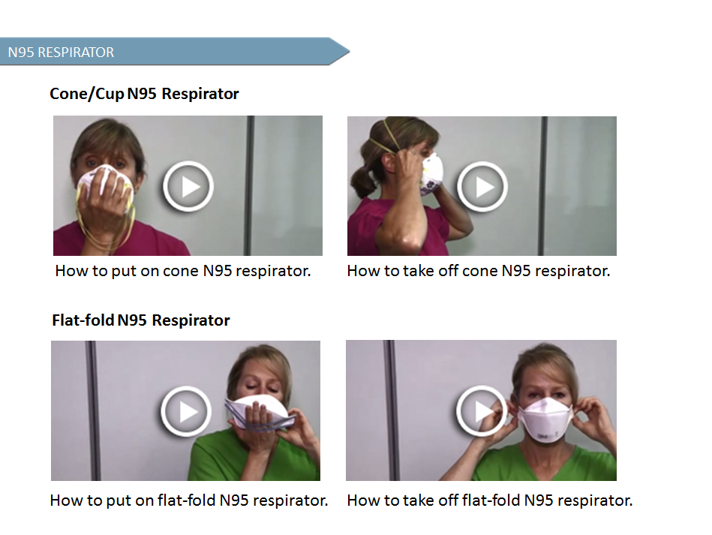

Slide 39
ELEMENTS OF AIRBORNE PRECAUTIONS - LTC
Cleaning
routine cleaning
Notes:
Cleaning
Routine environmental cleaning practices should be followed.

Slide 40
ELEMENTS OF AIRBORNE PRECAUTIONS - LTC
Equipment
follow Routine Practices
Notes:
Equipment
Follow Routine Practices for use and cleaning of shared medical equipment.

Slide 41
ELEMENTS OF AIRBORNE PRECAUTIONS - LTC
Communication to:
residents
families
other departments
other facilities
transport services prior to transfer
Notes:
Communication
It is important that you tell residents and their families why Airborne Precautions are in place. Also ensure that other departments, facilities or transport service providers are aware of the need for Airborne Precautions.

Slide 42
ELEMENTS OF AIRBORNE PRECAUTIONS - LTC
Transport
staff to wear N95 respirator
resident to wear a mask during transport
Notes:
Transport
Residents on airborne precautions should remain in their room. They must wear a mask during the transport and staff transporting them must wear an N95 respirator during the transport.

Slide 43
ELEMENTS OF AIRBORNE PRECAUTIONS - LTC
Visitors
discourage visitors from visiting
counsel about risk
Notes:
Visitors
Discourage visitors from visiting. Counsel visitors about the risks of visiting. Provide them with an N95 respirator and demonstrate how to perform a seal check.

Slide 44
STOP AND THINK
How have you used Additional Precautions?
What are some of the challenges you have experienced when using Additional Precautions?
How would you overcome those challenges?

Slide 45
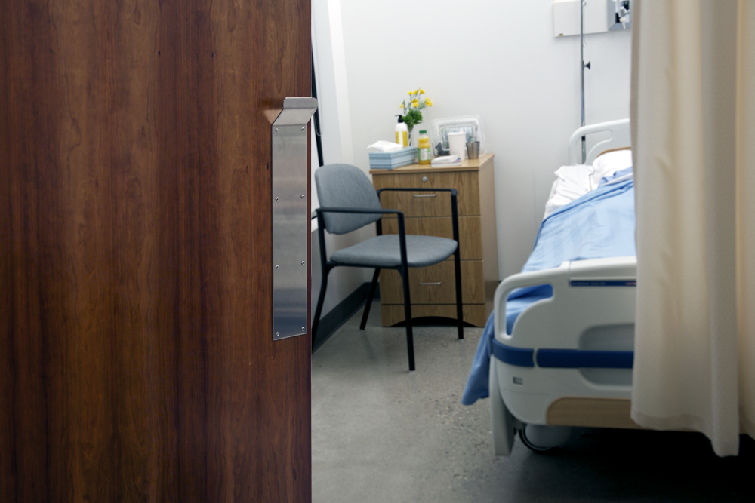
SUMMARY
Additional precautions are used in addition to Routine Practices when Routine Practices are not sufficient to prevent and control the transmission of infectious agents.
Categories of Additional Precautions are Contact, Droplet and Airborne. They may also be used in combination.
Elements of Additional Precautions may include accommodation, signage, Personal Protective Equipment (PPE), dedicated equipment, additional cleaning measures, limited transport and communication.
Additional Precautions should be initiated as soon as symptoms suggestive of a transmissible infection are noted, not only when a diagnosis is confirmed. Precautions need to remain in place until there is no longer a risk of transmission of infection.
Notes:
Let’s summarize some of the key principles of Additional Precautions. Additional Precautions are used in addition to Routine Practices when Routine Practices are not sufficient to prevent and control the transmission of infectious agents.
The three categories of Additional Precautions are Contact, Airborne and Droplet Precautions and these may be used in combination.
Elements of Additional Precautions may include accommodation, signage, Personal Protective Equipment or PPE, dedicated equipment, additional cleaning measures, limited transport and communication.
Initiate Additional Precautions as soon as symptoms suggestive of a transmissible infection are noted, not only when a diagnosis is confirmed.
Additional Precautions should remain in place until there is no longer a risk of transmission of infection.

