Slide 1
IPAC CORE COMPETENCIES ONLINE LEARNING COURSE
Routine Practices
Health Care Provider Controls Component
Copyright 2014
Notes:
IPAC Core Competencies Routine Practices
Health Care Provider Controls

Slide 2
General Introduction to Routine Practices
Routine Practices are infection prevention and control practices that are:
used routinely during all activities
used for all clients, patients and residents
used in all health care settings
to help prevent and control the spread of infectious agents.
Notes:
Routine Practices are the infection prevention and control practices that must be used routinely during all activities with all clients, patients, or residents, to help prevent and control the spread of Infectious Agents in all health care settings. No matter what health care setting you work in, Routine Practices always apply.

Slide 3
OVERVIEW
In this component, you will learn about:
Hand hygiene
Personal Protective Equipment (PPE)
Notes:
This component of the Routine Practices module will discuss hand hygiene and Personal Protective Equipment, or PPE. These are the controls that you, the Health Care Provider, can put in place to protect yourself and others to help prevent the transmission of infection.

Slide 4
OVERVIEW
After finishing this component, you will be able to:
Identify indications and proper technique for hand hygiene
Describe how PPE helps reduce the risk of infection in the health care environment
Assess need for PPE based on risk assessment
Notes:
After this component, you will be able to perform proper hand hygiene using the right technique and know “when” and “why” hand hygiene must be done. You will also be able to describe how Personal Protective Equipment helps reduce the risk of infection in the health care environment, and you will know how to select Personal Protective Equipment based on your risk assessment and use it appropriately.
In your workplace, you may be called “staff” or “health care provider” or “health care worker”. In this component, we’ll use the term “health care provider”.

Slide 5
OVERVIEW
Health Care Provider controls are:
measures that you use to protect yourself, clients/patients/residents, co-workers, and visitors from getting an infection
based on a risk assessment
last line of defense in the Hierarchy of Controls
Notes:
Health Care Provider controls are measures that you use to protect yourself, clients, patients, or residents, co-workers, and visitors from getting an infection. Performing a thorough risk assessment before each interaction with a client, patient, or resident is key to your decision-making around which Personal Protective Equipment to choose in a particular situation and whether there is a need to report deficiencies or defects in Personal Protective Equipment. Health Care Provider controls are your last defense in the Hierarchy of Controls when other controls may be absent or do not completely eliminate the risk.

Slide 6
OVERVIEW
Health Care Provider Controls:
hand hygiene
use of PPE, such as gloves, gowns, and facial protection
Notes:
Health Care Provider controls include understanding the importance of proper hand hygiene and using personal protective equipment such as gloves, gowns, and facial protection correctly.

Slide 7
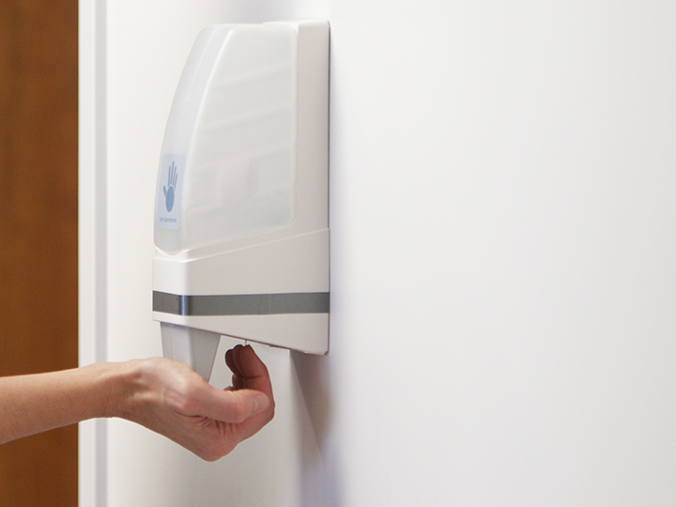
HAND HYGIENE
Hand hygiene is:
the most important and effective infection prevention and control measure you can do to help prevent health care associated infections
the responsibility of all individuals involved in health care
Notes:
Did you know that hand hygiene is the most important and effective infection prevention and control measure you can do to help prevent health care associated infections?
Hand hygiene is the responsibility of all individuals involved in health care.

Slide 8
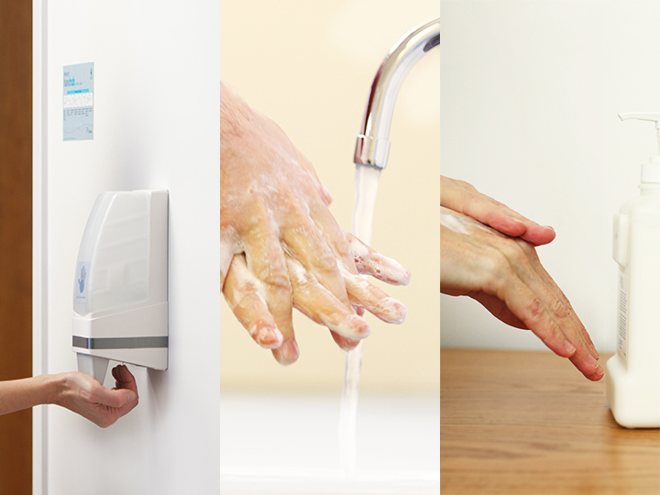
HAND HYGIENE
cleaning your hands with alcohol-based hand rub (ABHR) to kill microorganisms OR
washing your hands at a sink with soap and water to remove microorganisms AND
looking after your hands (hand care)
Notes:
Hand hygiene is a general term that refers to how to clean your hands. There are two ways you can perform hand hygiene. You already know that washing your hands at a sink with soap and water removes microorganisms. You can also perform hand hygiene with alcohol-based hand rub, or ABHR, which kills microorganisms.
Hand hygiene also includes taking care of your hands (also known as “hand care”).
Let’s look more closely at hand hygiene practice.

Slide 9
HAND HYGIENE
The Ontario “Just Clean Your Hands” program recommends:
using ABHR as the preferred method for hand hygiene when hands are not visibly soiled
using ABHR because it takes less time and is less harsh on the skin
performing hand hygiene according to the “4 Moments for Hand Hygiene”
educating Health Care Providers about hand hygiene benefits and proper techniques
providing a hand care program
Notes:
In Ontario, the “Just Clean Your Hands” program provides information about proper hand hygiene in health care settings.
For example: Using alcohol-based hand rub is the preferred method for hand hygiene when your hands are not visibly soiled.
When your hands are visibly soiled, you need to wash your hands at a sink with soap and water.
Health Care Providers need to learn about the “4 Moments for Hand Hygiene” according to the “Just Clean Your Hands” program. The “4 moments” will be discussed in more detail later in this component. This means those who work in health care need to clean their hands much more often than we realize based on the care activities we perform.
Audits of hand hygiene practice show that we, as Health Care Providers, clean our hands only about 40% of the time recommended by the “Just Clean Your Hands” program. We may think we are performing hand hygiene as often as we need to, but we are not.
Health Care Providers need to understand the benefits of hand hygiene and the proper techniques to perform hand hygiene to prevent the transmission of infection.
Lastly, Health Care Providers need to look after their hands by following a hand care program.

Slide 10
HAND HYGIENE
A hand care program includes:
hand care assessment
ABHR containing moisturizers
Health Care Provider referral to occupational health or to his/her Health Care Provider if skin integrity is an issue
hand care moisturizers that will not interfere with ABHR or damage gloves, and is approved by your organization
Notes:
Having healthy hands is essential for providing health care.
A hand care program includes a hand assessment. Ask yourself: “are my hands dry, sore, or chapped?” If your hands are sore, you may be reluctant to use alcohol-based hand rub to perform hand hygiene. That’s why you need to look after them!
Most alcohol-based hand rubs contain emollients, making them gentler on your skin.
If you have a skin condition on your hands, then you need to be referred to either occupational health or your own Health Care Provider.
Your health care facility should provide hand moisturizers that are compatible with alcohol-based hand rub products. This is important to help you have healthy hands.
Do not use petroleum-based products to protect your hands while at work because this might damage your gloves.

Slide 11
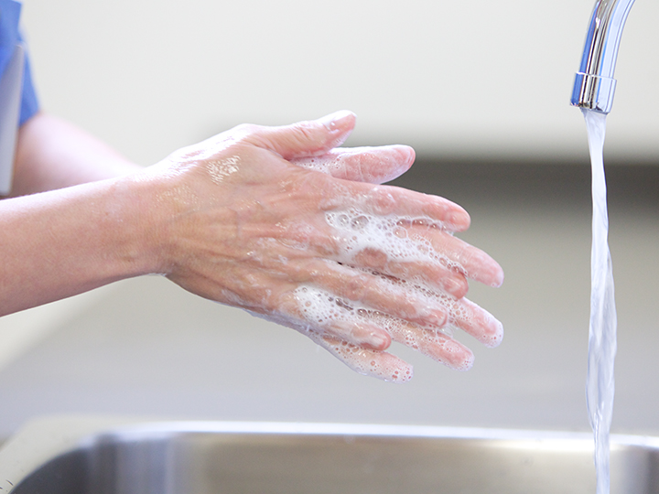
HAND HYGIENE
Proper hand hygiene is important in health care because it:
reduces the transfer of Infectious Agents to clients/
patients/residents
reduces the risk of infection
breaks the chain of transmission
Notes:
You might ask why hand hygiene is so important.
Your hands are the common link between your client, patient, or resident, the environment and equipment.
Remember the Chain of Transmission? Clients, patients, or residents, who may carry Infectious Agents, can act as a Reservoir in the Chain.
The health care environment and equipment can act as Reservoirs where Infectious Agents can live.
The health care environment is at higher risk for being contaminated with body fluids than other workplace settings. At work, your hands touch these body fluids, as well as surfaces and equipment. The majority of health care associated infections are caused by the contaminated hands of Health Care Providers. That’s why hand hygiene is so important!
When performed correctly, hand hygiene removes or kills the Infectious Agent and breaks the Chain of Transmission. Hand hygiene is the single most effective means of preventing the transmission of Infectious Agents, by all Health Care Providers, working with all clients, patients, or residents.

Slide 12
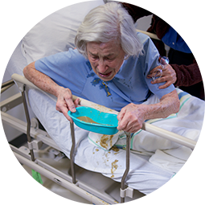
HAND HYGIENE
Hand hygiene must be performed:
after personal body functions, such as using the toilet or blowing one’s nose
before preparing, handling, serving or eating food
when hands accidentally come into contact with secretions, excretions, blood or body fluids (hands must be washed with soap and running water)
Notes:
We learned as children that we need to perform hand hygiene:
before preparing, handling, serving or eating food
after personal body functions, such as using the toilet or blowing one’s nose
when our hands accidentally come into contact with another person’s secretions, excretions, blood and body fluids.
Remember, when hands are visibly soiled, they must be washed with soap and running water.

Slide 13
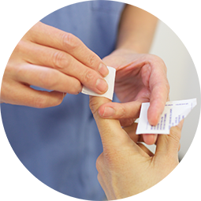
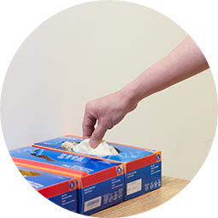
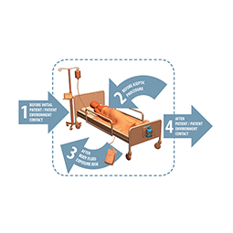
HAND HYGIENE
In health care, hand hygiene must also be performed:
whenever a Health Care Provider thinks his/her hands may be contaminated AND
before putting on and after taking off PPE
as indicated by the “4 Moments for Hand Hygiene”
Notes:
In health care, hand hygiene extends beyond what we learned as children. Remember to do a risk assessment before every interaction with a client, patient, or resident and his or her environment.
You need to perform hand hygiene before putting on and after taking off Personal Protective Equipment.
A good “rule of thumb” is to perform hand hygiene whenever you think your hands may be contaminated AND according to the “4 Moments for Hand Hygiene”.

Slide 14
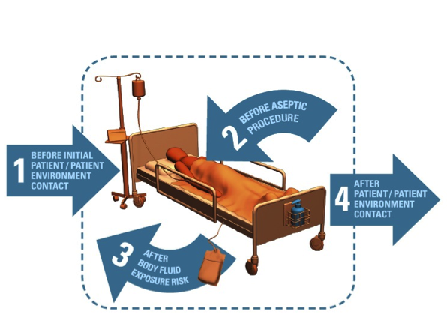
HAND HYGIENE
Notes:
In Ontario, we have the “Just Clean Your Hands” program.
Your “4 Moments for Hand Hygiene “are:
before initial client, patient, or resident contact, or contact with his or her environment
before any aseptic procedure, even if gloves are worn
after body fluid exposure risk, even if gloves are worn
after contact with your client, patient, or resident, or his or her environment

Slide 15
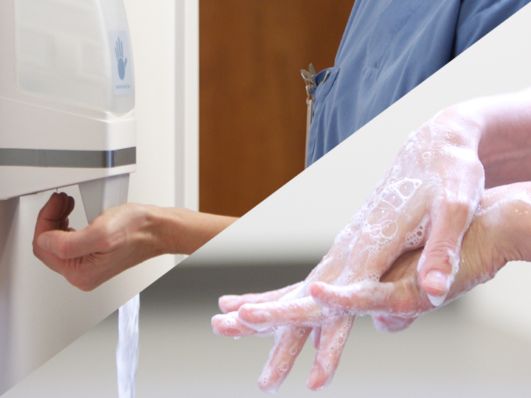
HAND HYGIENE
Hand Hygiene Methods:
Using alcohol-based hand rub with a concentration of 70 to 90% is the preferred method in health care settings
Washing hands with plain soap and running water must be done when hands are visibly soiled
If running water is not available, use moistened towelettes followed by ABHR.
Notes:
There are two ways to perform hand hygiene.
The preferred method for hand hygiene in health care settings is to clean your hands using alcohol-based hand rub. The correct concentration of alcohol-based product is 70-90% alcohol.
When your hands are visibly soiled, you need to clean your hands with plain soap and running water.
If running water is not available, use moistened towelettes followed by ABHR.
The following videos will show you how to perform hand hygiene effectively.

Slide 16
HAND HYGIENE: VIDEO
Notes:
Nail enhancements, rings and wrist jewellery can act as reservoirs for microorganisms and infectious agents and must not be worn by health care workers providing care. If a watch is worn it must be pushed up your arm to allow hands and wrists to be cleaned.
Check that your hands are visibly clean. If there is obvious soiling, follow the steps for hand washing.
Apply 1 to 2 pumps of product to the palms of your dry hand.
Rub hands together, palm to palm.
Rub in between and around your fingers.
Rub the back of each hand with the palm of the other hand.
Rub the fingertips of each hand in the opposite palm.
Rub each thumb clasped in the opposite hand.
Rub your hands until the product is dry. This will take a minimum of 15 seconds if sufficient product has been used.
Do not use paper towels to dry your hands.

Slide 17
HAND HYGIENE: VIDEO
Notes:
Nail enhancements, rings and wrist jewellery can act as reservoirs for microorganisms and infectious agents and must not be worn by health care workers providing care. If a watch is worn it must be pushed up your arm to allow hands and wrists to be cleaned.
Wet hands with warm water. Do not use water that is too hot or too cold, as it is hard on your skin and will lead to dryness.
Apply liquid or foam soap. In health care settings bar soap should not be used for hand washing because it is easily contaminated.
Lather soap and rub hands palm to palm.
Rub in between and around fingers.
Rub back of each hand with palm of other hand.
Rub fingertips of each hand in opposite palm.
Rub each thumb clasped in opposite hand.
After a minimum of 15 seconds, rinse hands thoroughly under running water. Be sure that all soap is removed as soap will dry out your skin.
Pat hands dry with paper towel. Rubbing with paper towels can damage the skin.
Turn off water using paper towel to avoid re-contaminating your hands.
Dispose of paper towel into waste container.

Slide 18
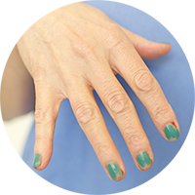
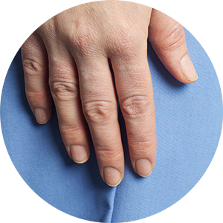
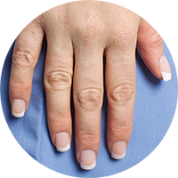
HAND HYGIENE
For those who have direct contact with clients/patients/residents:
Nail polish, if worn, must be fresh and not chipped.
Nails should be clean and short.
Artificial nails and nail enhancements are not to be worn.
Notes:
Long nails are difficult to clean, can pierce gloves, and harbour more Infectious Agents than short nails. Natural nails should be kept clean and short, not showing past the end of the finger.
Chipped nail polish or nail polish worn longer than 4 days can harbour Infectious Agents that are not removed by hand washing. Fingernail polish, if worn, must be fresh and have no chips.
Artificial nails and nail enhancements are not be worn by those having direct contact with a client, patient, or resident.

Slide 19
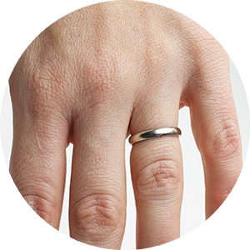
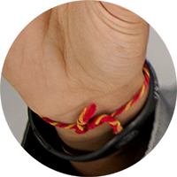
HAND HYGIENE
Hand and Wrist Jewellery
No projections or mounted stones
Rings should be limited to a smooth wedding band.
Wrist jewellery should not be worn.
Notes:
Rings and wrist jewellery, except for watches, are not to be worn when providing care. If facilities allow their Health Care Providers to wear a ring it must be a smooth band, with no projections or mounted stones.
Watches, if worn, should be able to be pushed up the arm far enough to allow hands and wrists to be cleaned appropriately.
Rings and wrist jewellery can act as Reservoirs for Infectious Agents. It is recommended they not be worn by Health Care Providers. If your usual role is to provide direct care, you should leave your jewellery at home.
Notes to Trainers/Facilitators: Consider having discussion 1 after presenting this slide.
The discussion questions for this part are the same for Acute Care, Long-term Care and Community Care. If you want to leave the questions to the end of the presentation, you can skip the following slide.

Slide 20
Discussion
How is hand hygiene in health care different than when you first learned to wash your hands?
Why is it important to take care of your hands?
How does hand hygiene contribute to infection prevention and control?

Slide 21
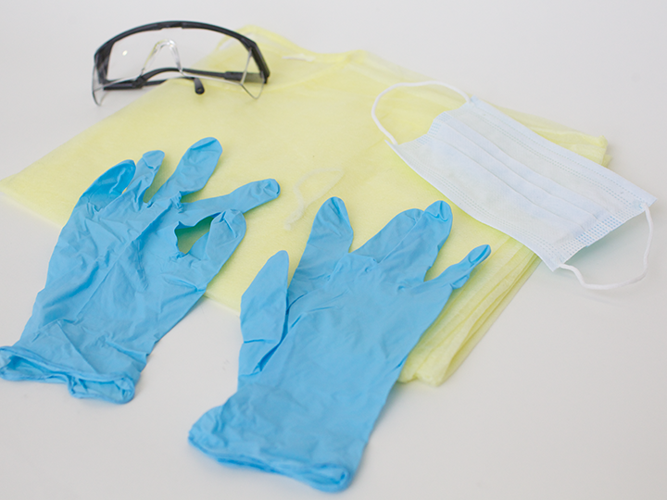
PERSONAL PROTECTIVE EQUIPMENT
Personal Protective Equipment (PPE):
is used to prevent transmission of infectious agents from:
patient-to-patient
patient-to-health care provider
health care provider-to-patient, and
health care provider-to-health care provider
is used alone or in combination
Notes:
Remember the discussion in the Occupational Health and Safety component of Routine Practices about protecting yourself from hazards? This is something you, as a health care provider, can control in your everyday work.
Personal Protective Equipment is used to prevent transmission of Infectious Agents from patient-to-patient, patient–to-Health Care Provider, health care provider-to-patient, and health care provider-to-health care provider. Gloves, gowns, and facial protection can be used alone or in combination. They prevent exposure by placing a barrier between the infectious source and one’s own mucous membranes, airways, skin and clothing or uniform.
In this way, you do your part in fulfilling the Internal Responsibility System.

Slide 22
PERSONAL PROTECTIVE EQUIPMENT
Choice of PPE is based on:
the nature of your interaction with your client/patient/resident
the likely Mode(s) of Transmission of Infectious Agents
your risk assessment
Notes:
As a health care provider, you are responsible to select the Personal Protective Equipment you need based on what you are going to do for your client, patient, or resident. It also depends on how the Infectious Agent may be transmitted. You need to perform a risk assessment before each and every interaction with your client, patient, or resident and his or her environment. Your decision to wear Personal Protective Equipment is based on the organizational risk assessment, your answers to your personal risk assessment questions and the item you will need to protect yourself when carrying out your task.
Making the correct choices and using Personal Protective Equipment properly, will help you to break the Chain of Transmission.

Slide 23
PERSONAL PROTECTIVE EQUIPMENT
Appropriate Uses of Personal Protective Equipment
.
Access PPE without contaminating the container or other items.
Perform hand hygiene before putting on and after taking off PPE.
Put PPE on immediately prior to each activity that requires it, as determined by your risk assessment.
Remove PPE immediately after the activity or task is done, and when soiled or damaged.
Notes:
Personal Protective Equipment protects the health care provider when used properly. It is important for you to know how to put on Personal Protective Equipment properly and how to remove it safely.
Always access Personal Protective Equipment without contaminating the container or other items. Remember to perform hand hygiene before putting on and taking off Personal Protective Equipment. Sometimes this is referred to as “donning” and “doffing”.
Put on Personal Protective Equipment just prior to the activity that requires it. Remove Personal Protective Equipment immediately after the activity, when soiled or damaged. Do not wear Personal Protective Equipment when it is not needed, since you might accidentally contaminate the environment.
Too often, health care providers are seen with gowns on in the cafeteria, or walking through the hall. How many times have you seen a health care provider with a mask dangling around their neck? It is important for health care providers to know when to wear Personal Protective Equipment and when to remove it!

Slide 24
PERSONAL PROTECTIVE EQUIPMENT
Responsibilities of Employers
Employers should:
provide appropriate PPE suitable to the task
provide quick and easy access to PPE
have guidelines on PPE in place
train health care provider on appropriate PPE use
evaluate the quality of PPE
Notes:
Employers also have responsibilities regarding Personal Protective Equipment. By law employers are required to ensure that appropriate PPE is worn. For example, the type of gloves that housekeepers use to protect their hands from chemicals when cleaning might be different from the type of gloves that a health care provider might use to protect their hands from an infectious agent.
Guidelines need to be in place regarding the use of Personal Protective Equipment and health care providers must be trained in how to use Personal Protective Equipment correctly. Any concerns about the quality of Personal Protective Equipment need to be addressed by the employer.

Slide 25
PERSONAL PROTECTIVE EQUIPMENT
Responsibilities of Workers
Workers should:
wear PPE when required
report to employer or supervisor if PPE is not available, is not appropriate for the task, or is damaged
Notes:
It is important for you, the health care provider, to wear PPE when required and based on your risk assessment. You must be trained in the proper way to put on and to take off Personal Protective Equipment. If you find that Personal Protective Equipment is not available, not available in your size or not appropriate for the task you need to do, you need to report this to your employer or supervisor. You should also report damaged Personal Protective Equipment or Personal Protective Equipment of poor quality.

Slide 26
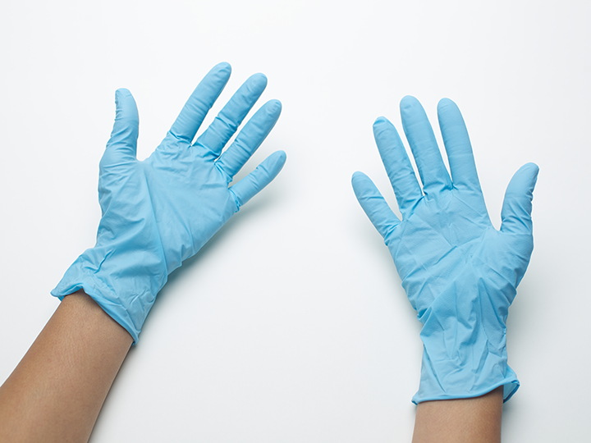
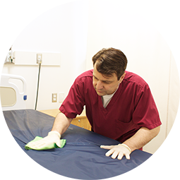
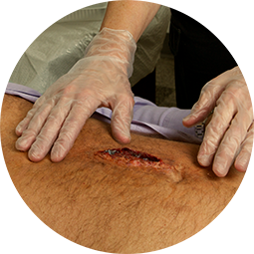
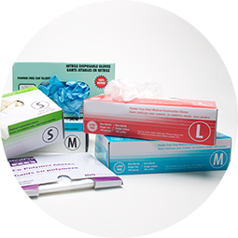
GLOVES
protect hands from contaminated equipment or environmental surfaces
Gloves:
protect the hands from infectious agents that may be present in blood, body fluids, non-intact skin, mucous membranes, secretions or excretions
are available in many types and sizes
Notes:
When you think about occupational health and safety, gloves may need to be worn for many different reasons, such as protecting yourself from chemical injury. This discussion about gloves will focus on infection prevention and control reasons for wearing gloves.
Think about all the fluids in the body such as blood, urine, and stool. Also think about being exposed to another person’s non-intact skin, like a wound or a cut, or their mucous membranes. Our bodies have many secretions and excretions.
A good rule of thumb is: if it’s wet and not yours, you need to wear gloves!
Wear gloves when your risk assessment suggests that your hands may be in contact with blood, body fluids, secretions, excretions or equipment and environmental surfaces contaminated with these. In this way, the infectious agents will go onto the gloves and not your hands.

Slide 27
GLOVES
Choose gloves based on organizational risk assessment and personal risk assessment.
Choice of Gloves:
Choose the best gloves for the task.
Notes:
Select the best gloves for the task you are about to do. Base your selection on the type of task you will be performing such as invasive procedures which require sterile gloves. Some tasks put more stress on the gloves and these tasks need a glove that has a good fit. Certain types of chemicals may damage some gloves. If you need to wear gloves for a long period of time you will need a stronger glove.
There are many types of gloves available for use in health care, such as vinyl gloves for short tasks with minimal exposure and; nitrile gloves for tasks of longer duration or contact with chemical agents
For more information about types of gloves and when to use them, refer to “Resources”.

Slide 28
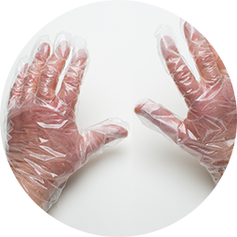
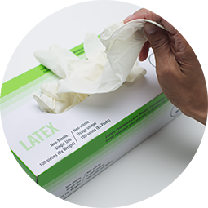
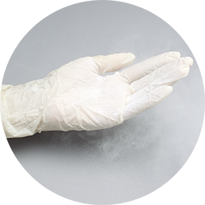
GLOVES
Types of Gloves to Avoid:
co-polymer “sandwich” gloves
latex gloves
powdered gloves
Notes:
Avoid latex gloves due to the risk of sensitivity and allergy. If you have a latex allergy or are sensitive to powders in gloves, consult your physician or occupational health service for guidance in choosing gloves. Do not wear co-polymer also known as “sandwich” gloves when providing care as they fit poorly and are not durable; they may tear easily.

Slide 29
GLOVES
For Routine Practices, you do not need to wear gloves when you:
are not providing direct health care
touch intact skin
use social touch (e.g. shaking hands)
Notes:
For Routine Practices, you do not need gloves for care activities in which you only touch intact skin. Here are some low risk activities which do not generally require the use of gloves.
taking blood pressure or pulse
bathing or dressing your client, patient, or resident
social touch, such as shaking hands
using a computer
pushing a wheelchair
feeding or delivering snacks or drinks
delivering clean linen
making a clean bed
The following video demonstrates the procedure for wearing gloves.

Slide 30
VIDEO: PUTTING ON GLOVES
Notes:
Nail enhancements, rings and wrist jewellery can act as reservoirs for microorganisms and infectious agents and must not be worn by health care workers providing care. If a watch is worn it must be pushed up your arm to allow hands and wrists to be cleaned.
Clean your hands before putting on gloves.
Wear gloves that fit well.
Pull glove on over the fingers of one hand, taking care not to puncture the glove by pulling too hard. Be sure the glove covers the wrist.
Repeat this action with the second glove on the other hand.

Slide 31
VIDEO: TAKING OFF GLOVES
Notes:
Remove gloves using a “glove-to-glove” and “skin-to-skin” technique. First, grasp the outside edge at the base of the palm.
Peel glove away from the palm toward the fingers, rolling the glove inside-out. Be careful not to touch your skin with your gloved hand. The contamination is now on the inside. Ball the glove up and hold it in your other gloved hand.
Carefully slide the un-gloved index finger inside the wrist band of the gloved hand. Try to avoid touching the outside of the glove because that is the contaminated region.
Gently pull outwards and down toward the fingers, removing the glove inside out.
Pull the glove down so that the first glove ends up inside the second glove so that no part of the outside is exposed.
Discard both gloves immediately into the garbage.
Clean your hands immediately after discarding gloves.

Slide 32
GLOVES
Always change your gloves between clients/patients/residents.
Appropriate Uses of Gloves
Always change your gloves when you go from a “dirty” area or task to a “clean” area or task on the same client/patient/resident.
Always make sure your hands are dry before putting on gloves.
Always remove gloves as soon as your task is done and when you are outside the immediate client/patient/resident care area.
Notes:
Always change your gloves between clients, patients, or residents.
[This prevents cross-contamination. It breaks links in the chain and helps prevent transfer of Infectious Agents from one client, patient or resident to another.]
Always change your gloves when you go from a “dirty” area or task to a “clean” area or task. [This helps to prevent cross-contamination or the transfer of Infectious Agents from the dirty site to the clean site. For example, putting on fresh gloves after changing a client, patient or residents’ brief and before you perform mouth care. Another example is changing your gloves after you clean a body fluid spill and before you make a bed.]
Always make sure your hands are dry before putting on gloves. [This is to help prevent hand irritation.]
Always remove gloves as soon as your task is done and when you are outside the immediate client, patient, or resident care area. [This helps prevent cross-contamination. It breaks links in the chain and helps prevent transfer of Infectious Agents from one client, patient or resident to another and prevents contamination of the environment.]

Slide 33
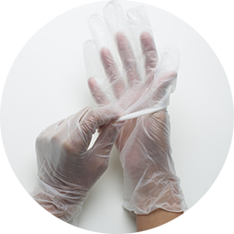
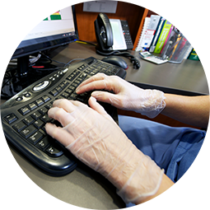
GLOVES
DO NOT wash gloves or use ABHR on gloves.
Inappropriate Uses of Gloves
DO NOT “double glove” or “triple glove”.
DO NOT wear gloves longer than needed.
Notes:
DO NOT “double glove” or “triple glove” [This contaminates the gloves and your hands when you remove the top glove. If you are doing this because your gloves are poor quality or inappropriate for the task, then you need to report this and use better quality gloves. ]
DO NOT wash gloves or use alcohol-based hand rub on gloves. [Disposable gloves are to be used once, and then thrown away. They are not to be re-used or cleaned. Alcohol-based hand rub is only to be used to perform hand hygiene.]
DO NOT wear gloves longer than needed.
[This helps prevent hand irritation and reduces the risk of contamination of the environment.]

Slide 34
GOWN
A Gown:
is to be used when your risk assessment suggests that a procedure or activity is likely to generate splashes or sprays of blood, body fluids, secretions, or excretions
protects your clothing/uniform and forearms from infectious agents
Notes:
Wear a gown when your risk assessment suggests that a procedure or activity is likely to generate splashes or sprays of blood, body fluids, secretions, or excretions that might contaminate your forearms and/or clothing or uniform.
You should also wear a gown to protect your arms and clothing from equipment or environmental surfaces contaminated with these body substances, such as when emptying commodes or bedpans.

Slide 35
GOWN
Choice of Gown:
must be appropriate to the task, based on risk assessment
can be reusable or disposable
must be long-sleeved with cuffs
must offer full coverage of the body front from neck to mid-thigh or below
Notes:
Your choice of a gown is based on the organizational risk assessment, your answers to your personal risk assessment questions and the type of gown you will need to protect yourself and the client, patient, or resident when carrying out your task. Select the best gown for the task you are about to do.
Gowns may be disposable. In this case, they will be used once, then, put into the garbage.
Cloth gowns are reusable. They are to be worn once, then, put into the laundry hamper.
The gown should have long sleeves and fit snugly at the cuff. Be sure that the gown fits you comfortably and completely; your clothing or uniform should be completely covered.
Several sizes of gowns should be available to ensure that Health Care Providers can select a gown that fits them.
The following video demonstrates the appropriate sequence for wearing a gown.

Slide 36
VIDEO: PUTTING ON GOWN
Notes:
Clean your hands before putting on gloves.
Wear a gown that fits well in size and length.
Hold the gown so that the opening faces you.
One arm at a time, put on the gown so the opening is at the back.
Pull the gown up over the shoulders.
Tie the neck and waist strings so that the gown overlaps.
If gloves are worn, pull the cuff of the glove over the cuff of the sleeve so that it fits snugly.

Slide 37
VIDEO: TAKING OFF GOWN
Notes:
If gloves are worn, remove gloves first and discard into garbage.
Remove the gown by untying the waist strings and then the neck strings.
Grasp the neck strings and use them to bring the gown forward and off the shoulders.
Roll the outside of the gown inwards, folding the contaminated outside layer away from your body. Do not agitate the gown.
Discard the gown into a linen bag or, if disposable, a garbage container.
Clean hands for 15 seconds.

Slide 38
GOWN
Appropriate Uses of Gown:
Always wear a gown with the opening at the back.
Always tie/fasten a gown both at the neck and waist.
Always choose a gown that fits you well.
Always remove your gown before leaving one client/patient/resident or his/her area and before going to another.
Notes:
Always wear a gown with the opening at the back. [This prevents soiling of your uniform or clothing beneath.]
Always tie or fasten a gown both at the neck and waist. [This prevents the gown from becoming loose or falling forward and contaminating your uniform or clothing.]
Always choose a gown that fits you well. [This ensures your gown provides adequate coverage of your uniform or clothing.]
Always remove your gown before leaving one client, patient or resident or his/her area and before going to another. [This will prevent cross-contamination.]

Slide 39
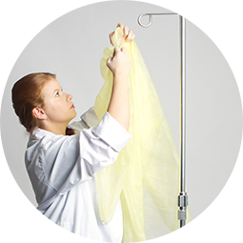
GOWN
DO NOT re-use gowns.
Inappropriate Uses of Gown:
DO NOT wear a lab coat or jacket instead of a gown.
DO NOT wear a gown just to keep warm.
Notes:
DO NOT wear a lab coat or jacket instead of a gown. [Lab coats or jackets do no provide adequate coverage as sleeves are not tight and the neck is open.]
DO NOT re-use gowns. [This will cause cross-contamination.]
DO NOT wear a gown just to keep warm. [Gown use should be restricted for infection prevention and control purposes.]

Slide 40
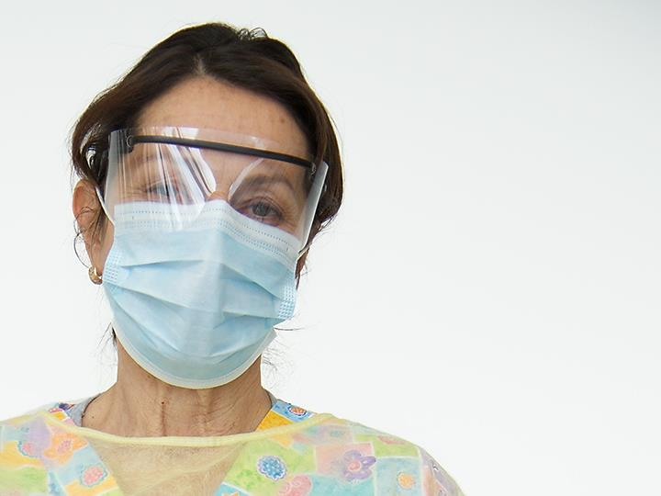
FACIAL PROTECTION
Facial Protection:
consists of a mask and eye protection
protects eyes, nose and mouth from droplet contact with infectious agents
Notes:
Facial protection for Routine Practices consists of a mask and eye protection that is worn to protect the mucous membranes of your eyes, nose and mouth when you anticipate that a procedure or care activity is likely to generate splashes or sprays of blood, body fluids, secretions or excretions OR when within two metres of a client, patient or resident with a new onset cough, fever or shortness of breath.

Slide 41
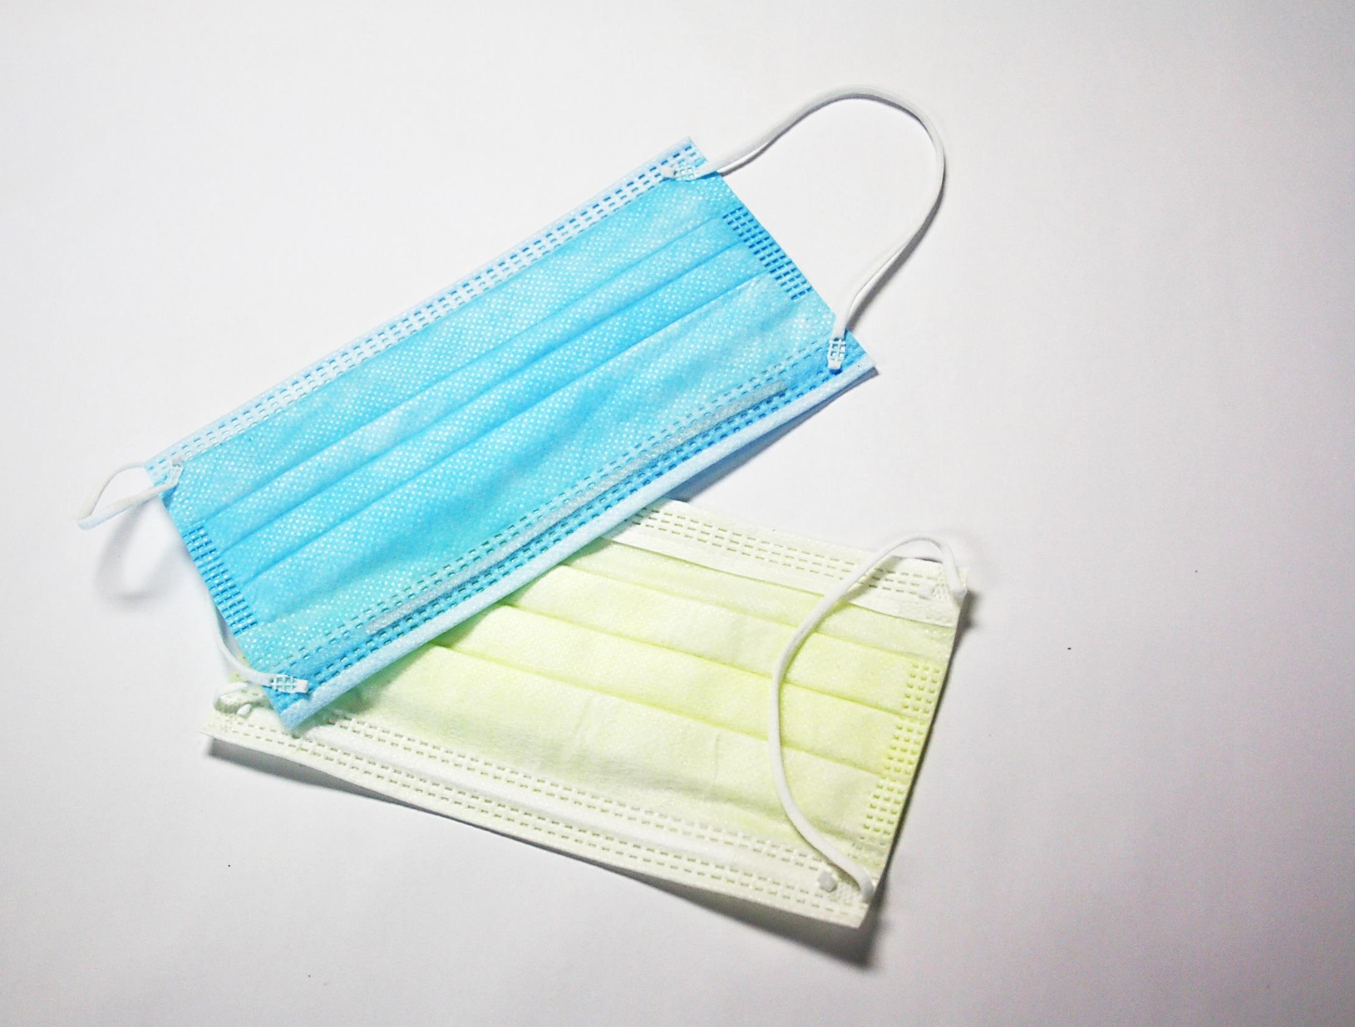
MASKS & RESPIRATORS
A Mask:
protects the nose and mouth from:
splashes or sprays of blood, body fluids, secretions or excretions
droplets from coughing or sneezing clients/patients/residents
is to be used when within two metres of a coughing client/patient/resident with symptoms of an acute respiratory infection
Notes:
A mask is to be used when your risk assessment suggests that your nose and mouth might be in contact with blood, body fluids, secretions or excretions that are splashed or sprayed by the task you are about to perform. Some examples include open suctioning, when performing dental procedures and when emptying a bedpan into an open hopper.

Slide 42
MASKS & RESPIRATORS
A Respirator:
filters out small airborne particles
prevents inhalation of airborne infectious agents (e.g., tuberculosis)
Notes:
A respirator filters small airborne particles to prevent the inhalation (or breathing in) of Infectious Agents such as tuberculosis, that are transmitted by the airborne route.
An N95 respirator is one type of respirator that is commonly used in health care settings.
Remember that when you wear an N95 respirator you must be fit-tested and you must perform a seal-check each time you put one on.
There is more information about N95 respirators in the Administrative Controls component of the Routine Practices module.
We will discuss N95 respirators and specific requirements for a Respiratory Protection Program in the Additional Precautions module.

Slide 43
MASKS & RESPIRATORS
Choice of Mask
Select a mask:
based on your risk assessment
substantial enough to prevent droplet penetration
securely covers your nose and mouth
that can last for the duration of activity
Notes:
Your choice of a mask is based on the organizational risk assessment and your personal risk assessment.
Select the best mask for the task you are about to do. For example, if there is a risk of splashing or spraying blood or body fluids onto the mask, choose a fluid-resistant mask. Your mask should be substantial enough to prevent droplet penetration and securely cover your nose and mouth. For long duration activities, choose a more durable mask, such as a surgical mask. As always, inform your supervisor or employer immediately if masks are inappropriate or unavailable.

Slide 44
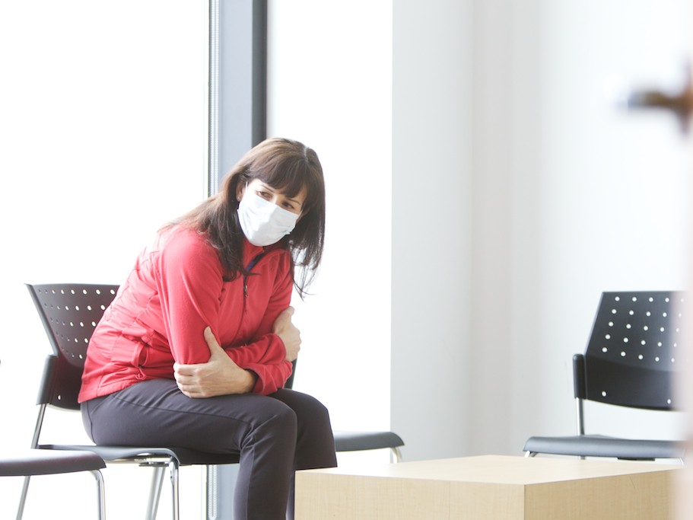
MASKS & RESPIRATORS
Masks for Clients/Patients/Residents
Clients/patients/residents with a new acute respiratory illness who are coughing should wear a mask (if tolerated):
when they leave their room
in ambulatory clinics and doctors’ offices
in ambulances
Clients/patients/residents should never wear an N95 respirator.
Notes:
Provide a mask to clients, patients, or residents who have a new acute respiratory illness and who are coughing when they leave their room, on arrival in clinics and doctors’ offices and when travelling in an ambulance.
Never use an N95 respirator on a client, patient, or resident. They have not been fit-tested and it may make their breathing difficult.

Slide 45
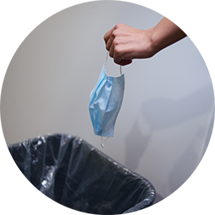
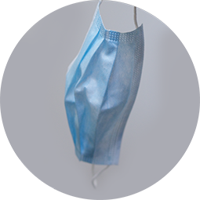
MASKS & RESPIRATORS
Always remove a mask immediately after the task for which it was used and discard into the garbage.
Appropriate Uses of Masks
Always wear a mask that fits your face.
Always discard a mask after you use it.
Notes:
Always wear a mask that fits your face. [This is to provide adequate protection for your nose and mouth.]
Always remove a mask immediately after the task for which it was used and discard into the garbage. [Masks should not be worn from room to room. Always prevent cross-contamination.]
Always discard a mask after you use it. [Choosing a new mask each time helps protect you from touching contaminated masks. A used mask is considered contaminated. Using a contaminated mask will contaminate your hands and put you and others at risk.]

Slide 46
MASKS & RESPIRATORS
DO NOT leave a mask around your neck or hanging from your ear or on your forehead.
Inappropriate Uses of Masks
DO NOT touch a mask while wearing it.
DO NOT store masks in your pocket.
Notes:
DO NOT touch a mask while wearing it. [The used mask is considered contaminated. Touching a contaminated mask will contaminate your hands and put you and others at risk.]
DO NOT leave a mask around your neck or hanging from your ear or on your forehead. [The used mask is considered contaminated. Touching a contaminated mask will contaminate your hands and put you and others at risk.]
DO NOT store masks in your pocket. [The used mask is considered contaminated. Touching a contaminated mask will contaminate your hands and put you and others at risk. The mask may become crushed and damaged.]

Slide 47
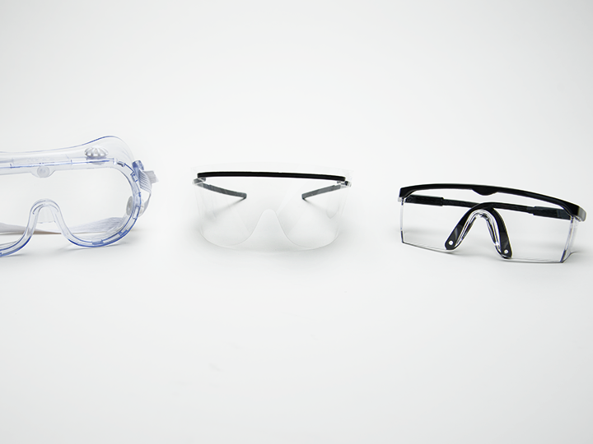
EYE PROTECTION
Eye Protection:
protects the eyes from:
splashes or sprays of blood, body fluids, secretions or excretions
droplets from coughing or sneezing clients/patients/residents
is to be used when within two metres of a coughing client/patient/resident with symptoms of an acute respiratory infection
Notes:
You should wear eye protection to protect yourself from Infectious Agents and another person’s body fluids.
This will protect the mucous membranes of your eyes from Infectious Agents that may be splashed, sprayed, coughed or sneezed towards your face.

Slide 48
EYE PROTECTION
Choice of Eye Protection
Select eye protection:
based on the risk assessment
with protection both in front of the eyes and at the sides
Eye protection may be disposable or reusable and includes safety glasses, safety goggles, face shields and visors attached to masks.
Notes:
Your choice of eye protection should be based on your risk assessment. It must provide protection both in front of the eyes and at the sides.
Prescription glasses are not acceptable eye protection. They will not protect you from Infectious Agents. Eye protection needs to be worn over prescription glasses.
Eye protection may be either disposable or reusable.
Examples of eye protection include safety glasses, safety goggles, face shields and visors attached to masks.
The following video demonstrates the procedure for wearing eye protection.

Slide 49
VIDEO: PUTTING ON MASK AND EYE PROTECTION
Notes:
Clean your hands before putting on mask and eye protection.
Choose a mask of correct size and fit. Mask should be able to perform for duration of activity.
Masks may have either ear loops or tie strings.
Simple ear loop mask
Place loops of the mask over each ear.
Bend the nose bar over the bridge of the nose so that the mask fits snugly over the nose and mouth to prevent fluid penetration.
Tie string mask
Position the mask over your nose and mouth. Bend the nose bar over your nose so that mask fits snugly. Grasp top tie strings and tie these at the back of your head. Then grasp the neck tie strings and tie the mask at the base of your head. Re-adjust the nose bar if needed.
Eye Protection
Choose eye protection of correct size and fit. Eye protection should not interfere with vision. If already wearing a combination mask + eye shield, additional eye protection is not needed.
Put on eye protection and adjust to fit. If you are wearing prescription eye glasses, wear eye protection over the eye glasses.
If you are using a face shield instead of a mask and eye protection, be sure the face shield fits securely over your brow and protects both your mouth and eyes.

Slide 50
VIDEO: TAKING OFF MASK AND EYE PROTECTION
Notes:
Remove eye protection immediately after completing the activity.
Before touching your eye protection, clean hands for 15 seconds.
Grasping the side pieces of the eyewear, remove by pulling it forward and away from the face. Avoid touching the contaminated front of the eyewear.
Discard disposable eye protection into the garbage container.
If eye protection is reusable, follow your organization’s policies for cleaning and disinfection. This might be done by you, or you might send the item to another area for cleaning and disinfection.
Remove mask by removing ear loops or untying strings. Carefully pull the mask forward and away from the face, avoiding touching the outside of the mask.
Drop the mask into the garbage container without contaminating the top edges of the waste bag.
If wearing combination mask and eye protection, untie the neck strings first, then untie the head strings. Bending the head, hold the mask firmly with the ties and carefully allow the mask to fall forward and off the face. Avoid touching the front of the mask or eye protection with the hands.
Drop the mask into the garbage container without contaminating the top edges of the waste bag.
If wearing a full face shield, grasp the head band at the back of the hand with one or both hands and lift it up and forward, off the head. Avoid touching the front of the face shield.
Drop the face shield into the garbage container .
Perform hand hygiene.

Slide 51
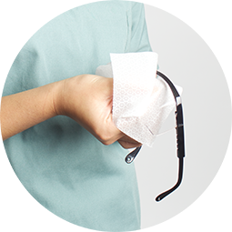
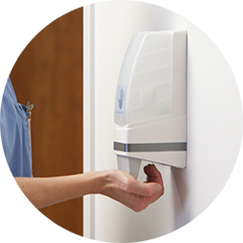
EYE PROTECTION
Always clean and disinfect reusable eye protection before the next use.
Always put disposable eye protection in the garbage after use.
Always perform hand hygiene before removing eye protection.
Always remove your eye protection immediately
after the task for which it
was used and discard into
the garbage or place in an appropriate receptacle for cleaning and disinfection.
Notes:
Always put disposable eye protection in the garbage after use. [This prevents cross-contamination.]
Always clean and disinfect reusable eye protection before the next use. [This prevents cross-contamination and avoids putting you and others at risk. Handle and store contaminated equipment safely to protect others and storage areas from becoming contaminated.]
Always perform hand hygiene before removing eye protection. [This is so your hands are always clean before you touch your face and helps protect you from infection.]
Always remove your eye protection immediately after the task for which it was used and discard into the garbage or place in an appropriate receptacle for cleaning and disinfection. [Proper handling and disposal prevents cross-contamination.]

Slide 52
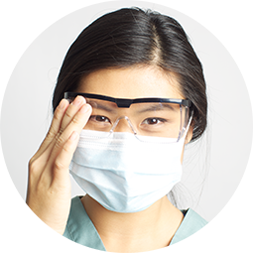
EYE PROTECTION
DO NOT touch eye protection while wearing it.
DO NOT wear prescription eye glasses in place of eye protection.
DO NOT put eye protection on top of your head when not in use.
DO NOT disinfect or reprocess disposable eye protection.
Notes:
DO NOT wear prescription eye glasses in place of eye protection. [Wearing prescription glasses does not provide adequate protection and may not protect your eyes from exposure to Infectious Agents in splashes or sprays.]
DO NOT touch eye protection while wearing it. [This may cause contaminate both your hands and your eye protection.]
DO NOT put eye protection on top of your head when not in use. [Used eye protection is considered contaminated. Touching it will contaminate your hands and put you and others at risk.]
DO NOT disinfect or reprocess disposable eye protection. [This may compromise the integrity of the eye protection.]
Notes to Trainers/Facilitators: Consider having discussion 2 after presenting this slide.
The discussion questions for this part are the same for Acute Care, Long-term Care and Community Care. If you want to leave the questions to the end of the presentation, you can skip the following slide.

Slide 53
Discussion Two
What questions do I need to ask myself before I choose PPE?
Why is it important to remove PPE in a certain sequence?
How does wearing PPE contribute to infection prevention and control?

Slide 54
VIDEO: SEQUENCE FOR PUTTING ON PPE
Notes:
The following video demonstrates the appropriate sequence for taking off Personal Protective Equipment.
Perform hand hygiene.
Put on gown.
Put on mask.
Put on eye protection.
Put on gloves.

Slide 55
VIDEO: SEQUENCE FOR TAKING OFF PPE
Notes:
Remove gloves.
Remove gown.
Perform hand hygiene.
It is important to clean your hands after removing gown and gloves to make sure that infectious agents are removed before you touch your face.
Remove eye protection.
Remove mask.
Perform hand hygiene.
It is important to clean your hands after removing facial protection because they are considered to be contaminated.
Notes to Trainers/Facilitators:
If you have skipped the discussions, it’s time to arrange the discussions.
Practice activities can be introduced after presenting this slide.

Slide 56
Hand hygiene is the most important and effective infection prevention and control measure you can do to help prevent health care associated infections. Using alcohol-based hand rub is the preferred method for hand hygiene in health care settings.
PPE such as gloves, gowns, facial protection helps to safeguard health care workers and others from infection. The proper sequence of taking off PPE must be followed.
Employers must provide appropriate personal protective equipment (PPE) and make sure it is easily accessible.
All health care providers must select and use PPE correctly when there is a risk of exposure to infectious agents.
SUMMARY
Notes:
Hand hygiene is the single most important action you can do to prevent the transmission of infection. Using alcohol-based hand rub is the preferred method for hand hygiene in health care settings.
PPE such as gloves, gowns, facial protection helps to safeguard health care workers and others from infection. The proper sequence of taking off PPE must be followed.
Employers must provide appropriate personal protective equipment (PPE) and make sure it is easily accessible. All health care providers must select and use PPE correctly when there is a risk of exposure to infectious agents.
Notes to Trainers/Facilitators: Please administer the test after presenting the summary.

Slide 57
Thank you
Copyright 2014

